Slide 1
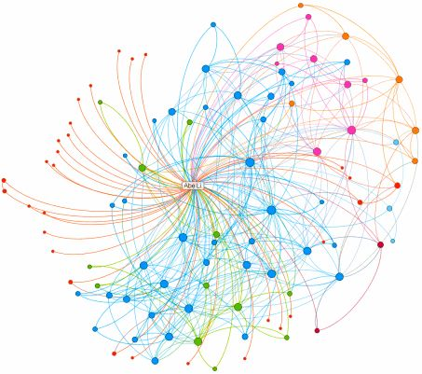
2018 15th IEEE International Conference on Sensing, Communication and Networking
Online Incentive Mechanism for Mobile Crowdsourcing based on Two-tiered Social Crowdsourcing Architecture
Jia Xu, Chengcheng Guan, Haobo Wu, Dejun Yang, Lijie Xu, Tao Li
School of Computer, Jiangsu Key Laboratory of Big Data Security & Intelligent Processing, Nanjing University of Posts & Telecommunications

Slide 2
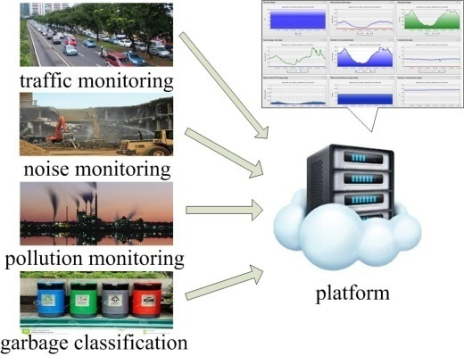
Crowdsourcing with Mobile Phone
Accelerometer
light sensor
Digital Compass
Microphone
Camera
GPS
proximity sensor
Notes:
Smartphones are integrated with a variety of embedded sensors.
It has been applied in various domains, such as WiFi maps, noise maps, traffic information.

Slide 3
Incentive Mechanisms for Mobile Crowdsourcing
Power
Memory
Computing ability
TIME
Privacy
compensate users’ cost
help to achieve good service quality

Slide 4
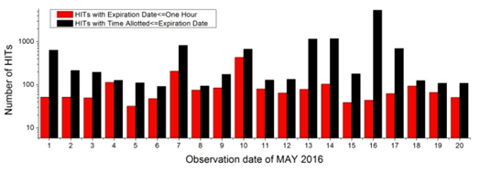
Insufficient Participants
6.02%
3.83%
618.65
Notes:
Amazon Mechanical Turk

Slide 5
Basic Idea
Spread the sensing tasks to the social network to attract more smartphone users.

Slide 6
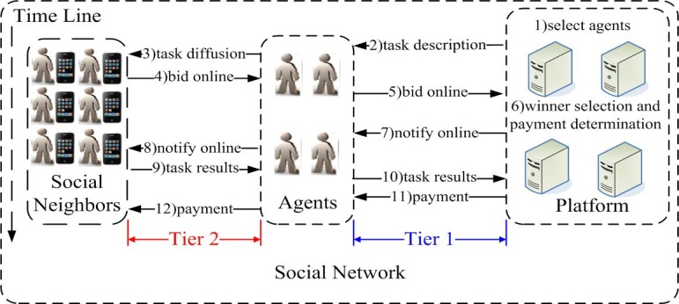
Two-tiered Social Crowdsourcing Architecture

Slide 7
Objective
Designing truthful incentive mechanisms to maximize the total value for platform under the budget constraint online setting
Challenges
Practical system model for the two-tiered social crowdsourcing system
Make decision before users depart
How to select the agents? online durations or influence?
Strategic behavior by submitting dishonest bid price or arrival/departure time

Slide 8
Agent Selection
Objective: The cumulative online durations of the selected agents are desirable to cover the tasks as many as possible.
Constraint: The unit influence of any agent is larger than the constant $δ$

Slide 9
Coverage
Select the users with maximum marginal coverage

Slide 10
Unit Influence
Measure the matching of interests
$$Jac\left(Γ^{j},i\right)=\frac{|T^{j}∩I_{i}|}{{|T}^{j}∪I_{i}|}$$
Influence function
$$I\left(Z,I_{max}\right)=\left(I_{max}−1\right)\sqrt{1−{\left(1−Z\right)}^{2}}+1$$
Unit influence
$$\frac{\sum_{i∈{SN}^{j}}{I\left(Jac\left(Γ^{j},i\right),I_{max}\right)}}{|ℋ^{j}|}$$
Notes:
Jaccard Similarity Coefficient

Slide 11
Online Reverse Auction
Step1:
For each user who is online
Winner Selection & Payment Determination
Find i with maximum marginal value
If $b_{i}≤\frac{V_{i}\left(S^{j}\right)}{ρ}≤ℬ^{j}−\sum_{i^{′}∈S^{j}}{p_{i^{′}}}$, add user i into winner set
Step2:
Density Threshold Updating
$$p_{i}←V_{i}\left(S^{j}\right)/ρ$$
Step3:
End for
Adjustment for Online Users
Notes:
inequation

Slide 12
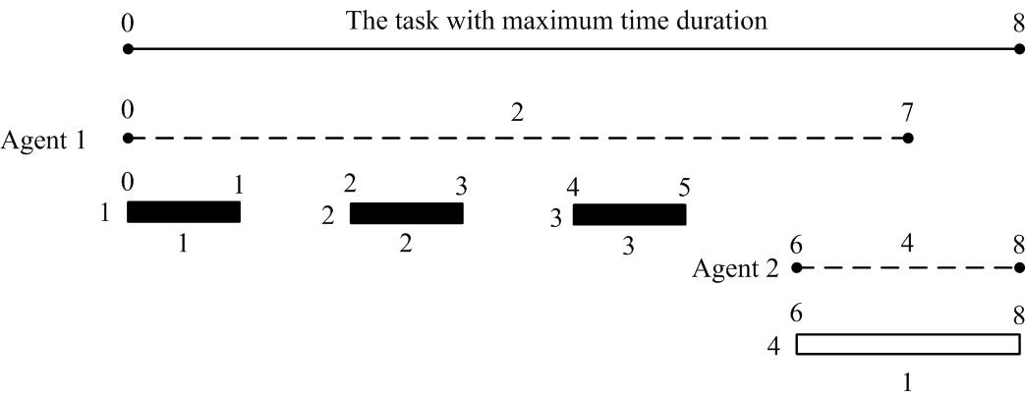
Online Reverse Auction
Step1:
Winner Selection & Payment Determination
Step2:
Density Threshold Updating
Step3:
Update the density threshold
Adjustment for Online Users
multiple-stage sampling accepting process
Notes:
Jaccard Similarity Coefficient

Slide 13
Online Reverse Auction
Step1:
Input: agent k’s budget $ℬ^{k}$, sample set S'
$𝒢←∅$;$i←arg\max_{j∈S^{′}}\frac{V_{j}(𝒢)}{b_{j}}$;
while $b_{i}≤\frac{V_{i}(𝒢)ℬ^{k}}{V(𝓖∪\{i\})}$ do
$𝓖←𝓖∪\{i\})$;
$i←arg\max_{j∈S^{′}\backslash 𝒢}\frac{V_{j}(𝒢)}{b_{j}}$;
end
return $V(𝒢)/ℬ^{k}$;
Winner Selection & Payment Determination
Step2:
Density Threshold Updating
Step3:
Adjustment for Online Users
Repeat Step1 for online users
Notes:
Jaccard Similarity Coefficient

Slide 14
A Walk-through Example
Arrival time
Budget
Departure time
Cost
Each social neighbor has the same marginal value 1/2. $ρ=1/2$.

Slide 15
A Walk-through Example
Arrive time
Budget
Depart time
Cost
$𝓉=0$: $S^{1}=∅$, $ρ=1/2$, $b_{1}=1≤\frac{V_{1}\left(S^{1}\right)}{ρ}=\frac{1/2}{1/2}=1≤ℬ^{1}=2$, thus $p_{1}=\frac{V_{1}\left(S^{1}\right)}{ρ}=1$, $S=\{1\}$.

Slide 16
A Walk-through Example
Arrive time
Budget
Depart time
Cost
$𝓉=2$: $S^{1}=\{1\}$, $ρ=1/2$, $b_{2}=2>\frac{V_{2}\left(S^{1}\right)}{ρ}=\frac{1/2}{1/2}=1$, thus $p_{2}=0$.

Slide 17
A Walk-through Example
Arrive time
Budget
Depart time
Cost
$𝓉=4$: $S^{1}=\{1\}$, $ρ=1/2$, $b_{3}=3>\frac{V_{3}\left(S^{1}\right)}{ρ}=\frac{1/2}{1/2}=1$, thus $p_{3}=0$.

Slide 18
A Walk-through Example
Arrive time
Budget
Depart time
Cost
$𝓉=6$: $S^{2}=∅$, $ρ=1/2$, $b_{4}=1≤\frac{V_{4}\left(S^{2}\right)}{ρ}=\frac{1/2}{1/2}=1≤ℬ^{2}=4$, thus $p_{4}=1$, $S=\{1, 4\}$.

Slide 19
A Walk-through Example
Arrive time
Budget
Depart time
Cost
$𝓉=7$: $d^{1}=𝓉$ $S^{′}=\{1, 2, 3\}$, $ℬ^{1}=2$, update $ρ=1/4$. $b_{4}=1≤\frac{V_{4}\left(S^{2}\backslash \{4\}\right)}{ρ}=\frac{1/2}{1/4}=2≤ℬ^{2}−p_{4}+p_{4}=4$, and $\frac{V_{4}\left(S^{2}\backslash \{4\}\right)}{ρ}=2>p_{4}=1$, thus increase $p_{4}$ to 2.

Slide 20
Theoretical Analysis
Lemma 1. MTSC is computationally efficient.
Agent Selection: $O(max\left\{\max_{j∈J}\left|{SN}^{j}\right|nm^{2},n^{2}\right\})$ Online Reverse Auction: $O(|SN|m^{2})$
Lemma 2. MTSC is individually rational.
Each user will have a non-negative utility
Lemma 3. MTSC is budget feasible.
The total payment to the users is smaller or equal to the total budget
Lemma 4. MTSC is truthful (cost-truthful and time-truthful).
No user can improve its utility by submitting false cost, arrival/departure time, no matter what others submit.

Slide 21
Performance Evaluation
Three Benchmark algorithms:
Approximate optimal (offline)[S. Khullera,1999]:
untruthful, with full knowledge, $(1−1/e)$ approximation
Proportional share (offline)[Y. Singer,2010]:
truthful, using the proportional share rule
Random (online):
truthful, selecting the agents randomly
Dataset: social circle data from Facebook

Slide 22
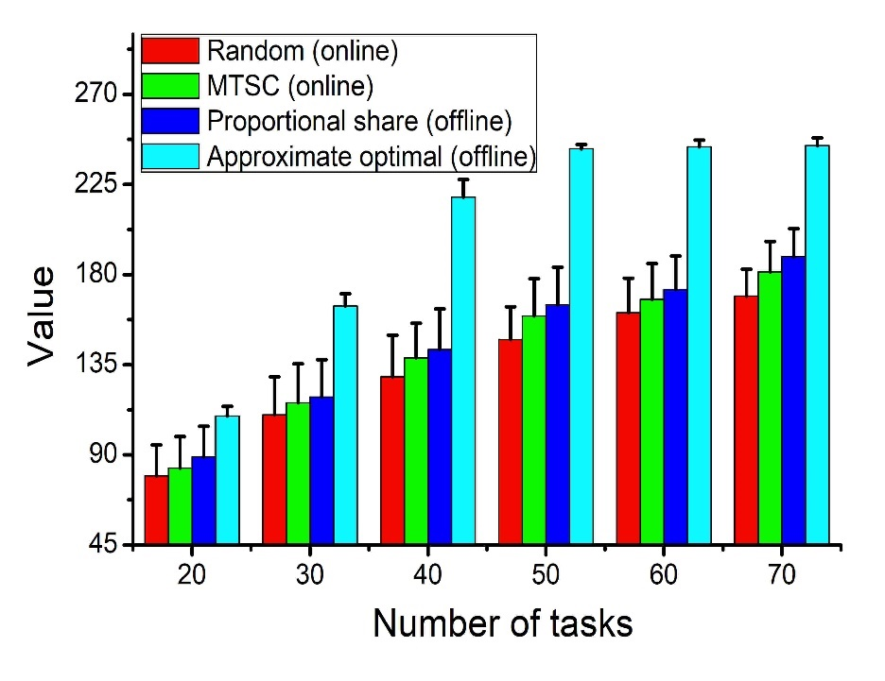
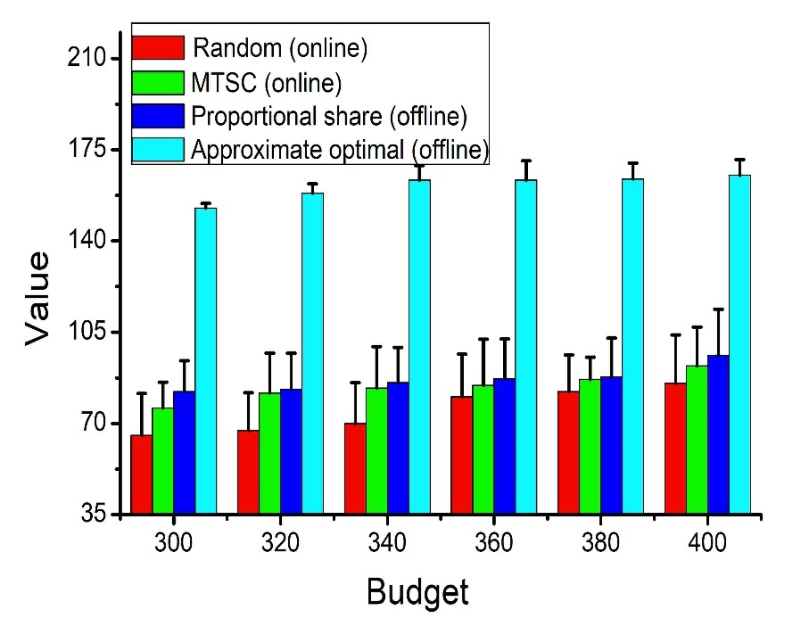
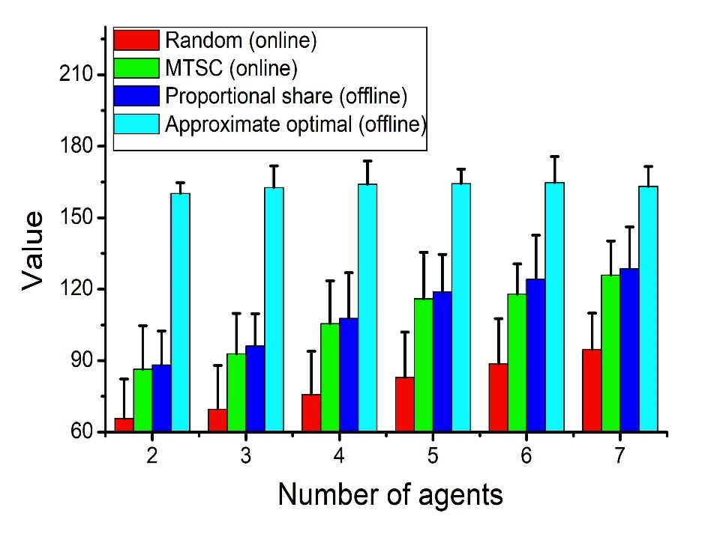
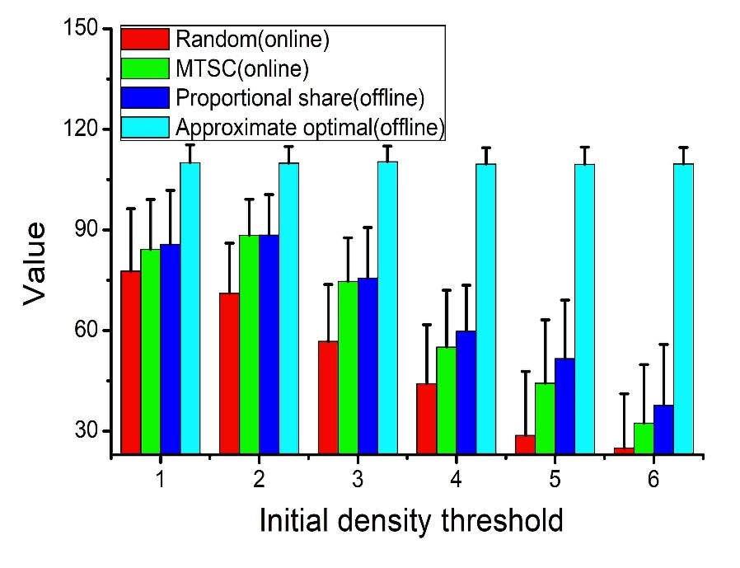
A. Value
The MSTC always achieves better performance than random mechanism.
The gap between MSTC and Proportional Share (the best in truthful offline mechanisms) is very small.

Slide 23
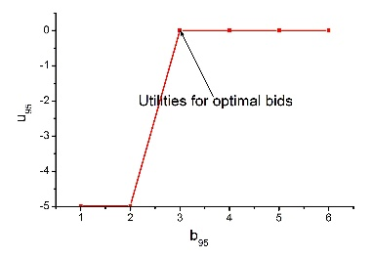
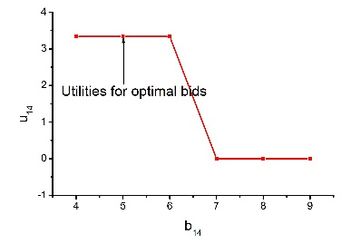
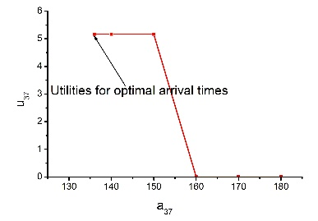
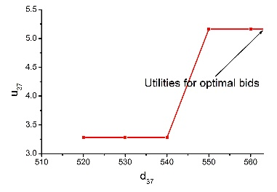
B. Truthfulness
The users cannot improve their payoff by submit false cost, arrival time or departure time.
(a)$c_{14}=5$ (b)$c_{95}=3$
(c) ${ra}_{37}=136$ (d) ${rd}_{37}=563$

Slide 24
Conclusion
We present a two-tiered social crowdsourcing architecture to solve the insufficient participation problem using the social network in online scenario.
We propose the Agent Selection algorithm based on the historical information to optimize the online duration coverage and the unit influence simultaneously.
We design the Online Reverse Auction for selecting the social neighbors and calculating payments. We show that the designed auction satisfies the desirable properties of computational efficiency, individual rationality, budget feasibility, and truthfulness.

Slide 25
Thank You!
Q & A
http://faculty.cs.njupt.edu.cn/~xujia/home.html
xujia@njupt.edu.cn

