Slide 1
Fog Following Me:
Latency and Quality Balanced Task Allocation in Vehicular Fog Computing
Chao Zhu, Giancarlo Pastor, Yu Xiao, Yong Li, Antti Ylä-jääski
Notes:
Good afternoon everyone. My name is Chao Zhu and I am from aalto university, Finland. I am very glad to give this talk today. My topic is as listed in the slide. In this work, we want to explore the latency and quality balanced task allocation in vehicular fog computing.

Slide 2
What is Vehicular Fog Computing (VFC)?
Notes:
So. What is vehicular fog computing?

Slide 3
Fog v.s. Cloud
Vehicular Fog Computing
Vehicular Cloud Computing
Notes:
Here, we first introduce the current architecture of vehicular networking, we can call it vehicular cloud computing. The vehicular cloud computing utilize a centralized way to process data and conduct service for vehicular applications. All the data generated from the client would be transmitted to the servers located in datacentres. Then, the data processing and specific service would be also conducted in there. However, these datacenters may be remotely located from the place where data generated.
Different from cloud computing, the fog or we can call edge computing, is a new computing and communication menchanism that pushes the intelligence resource to the place where the data generated and act upon. Here, we adopt the concept of fog computing into vehicular network and propose a new architecture, called vehicular fog computing. For simple, we call it VFC.
In VFC, we turn some specific vehicles, such as buses and taxis into edge servers and we call them mobile fog nodes. Furthermore, we turn some infrastructures, such as base stations and road side units into stationary fog nodes. As shown in the slide, the client vehicle can transmit the on-board video or image to the fog ndoes within one-hop and the application services can also be conducted upon the fog nodes.
Compare with vehicular cloud computing, VFC has some benefits. First, the communication between the clients and servers is limited within one-hop, thus shortcut the communication hops and transmission latency. Second, since some fog nodes can move around, we can conduct on-demand service with the benefits of vehicle’s mobility. Third, there are many license-free access technologies, such as dsrc, in D2D communication. The last is that the service conducted by vehicular fog computing is location-aware because the server is geographic close to where the service is generated.

Slide 4
Why we need VFC?
Notes:
So, why we need VFC?

Slide 5
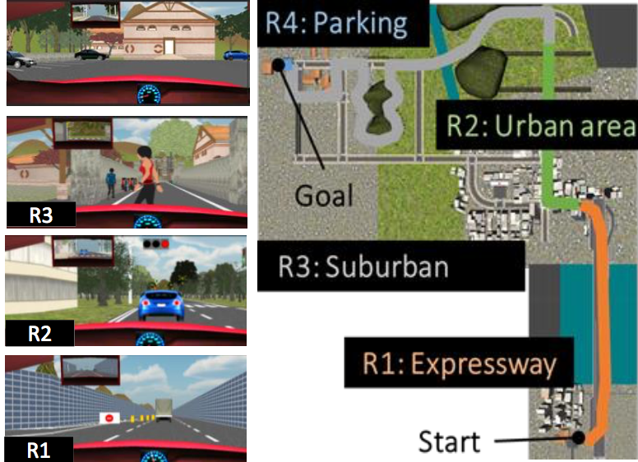
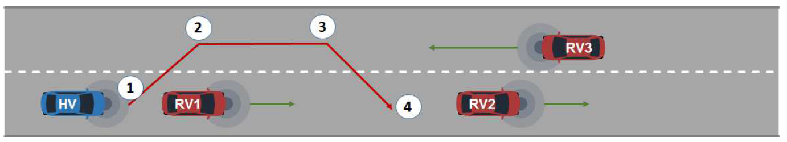
Emerging Vehicular Applications
AR Assistant Driving
3D High-precision Map
See-through for Passing
Notes:
This is because there are a lot of new type of application are emerging. Such as ar assistant driving, 3D high-precision map for autonomous driving and see-through application for safe lane change.

Slide 6
Service Requirements
Strict Latency Requirement
  Transmission Latency
  Processing Latency
High Bandwidth Cost
Location-aware Service
High Sevice Quality Requirement
Notes:
These application have some common features. They are very sensitive for latency, which include transmission latency and service processing latency. Furthermore, they cost a lot of bandwidth. Mostly, the vehicular applications are toward location-aware service and require a high service quality. And VFC meet all these demands compared with vehicular cloud computing.

Slide 7
Tasks and tasks allocation
Notes:
So, we explore the task allocation in this work. And what’s the meaning of task and how to conduct task allocation?

Slide 8
Tasks
Video Streaming
AR Assistant Driving
Object Recognition
Notes:
Here, we consider the task as the atom component of application service. For example, in the AR assistant driving application, the service contain two types of tasks, video streaming and object recognition. In this work, we try to allocate these atom task to the fog nodes surrounding the client vehicles.

Slide 9



Task Allocation
Zone Head
Enter Zone Notification
Leave Zone Notification
Mobile Fog Node
Notes:
Here we illustrate the architecture of our task allocation system. It is safe to assume that urban areas in
modern cities are fully covered by cellular networks. Thus, we divide an urban area into Service Zones , and select a stationary fog node within the zone to manage and coordinate all the fog nodes. The coordinator is called Zone Head . To simplify the system model, we always select a LTE base station to be the zone head. Mobile fog nodes always inform the zone head when they enter or leave the zone, utilizing the existing cellular registration mechanisms. Additionally, they report periodically their locations, moving directions, and available capacities to the zone head. Thus,all informations about fog nodes, client vehicles, and base stations are transparent to system.
In the task allocation in VFC, the client vehicle first broadcasts one-hop probe messages over DSRC for the discovery of mobile fog nodes. The fog nodes responsing the probe are listed as fog condidates. After receive the response of mobile fog node, the client vehicle send a request to the zone head. The request message contains the task ID, application type, fog candidates, location and speed of vehicles. After the zone head received the request, it will conduct task allocation algorithm and inform all the clients and mobile fog nodes about the task assignment decision over LTE.

Slide 10
Our objective…
Notes:
So, what are our objectives?

Slide 11
Objectives and Constraints
Objectives
  Service Latency
  Service Quality
Constraints
  Quality Loss Tolerance
  Service Latency Tolerance
  Capacity/Resource Limitation
Notes:
Our obective is reduce the service latency and keep the service quality as high as possible. We also consider the service constraints, such as quality loss tolerance, service latency tolerance and servers‘ capacity.

Slide 12

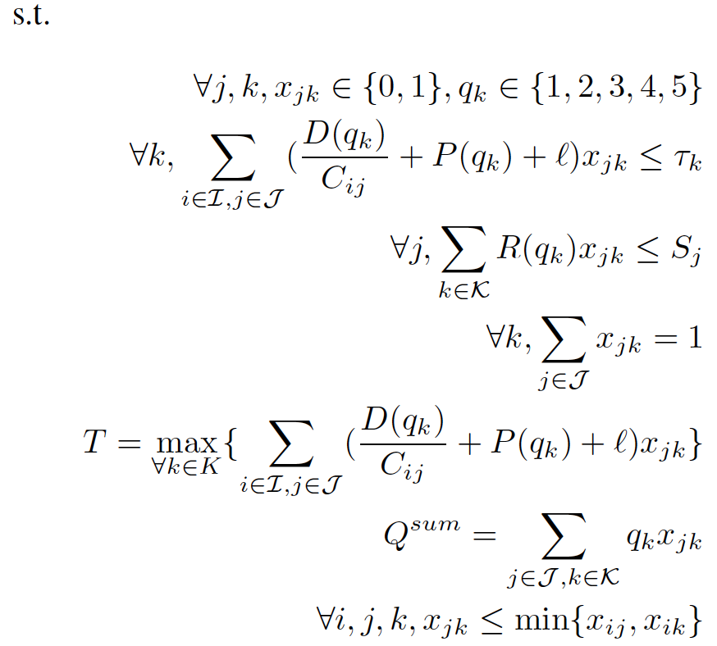
Problem Formulation
Scalar Weights
Latency Tolerance
Resource Limitation
Task Unsplittable
Notes:
Here are the equations of our problem. Here, k represents the task and j represents the mobile fog node. Thus, x_jk represents the task allocation decision. q_k represents the service quality. P(q_k) is the relationship between processing time and service quality. R(q_k) is the relationship between resource consumption and service quality.
F_t and f_q are two scalar weights. We can tune these variables depend on our appeal. If you value latency, then tune f_t up, and vice versa.

Slide 13

What do the P($q_{k}$) and R($q_{k}$) look like? Can the problem be linearized?
Notes:
So, what’s the P(q_k) and R(q_k) looks like? And can the problem be lineared?

Slide 14
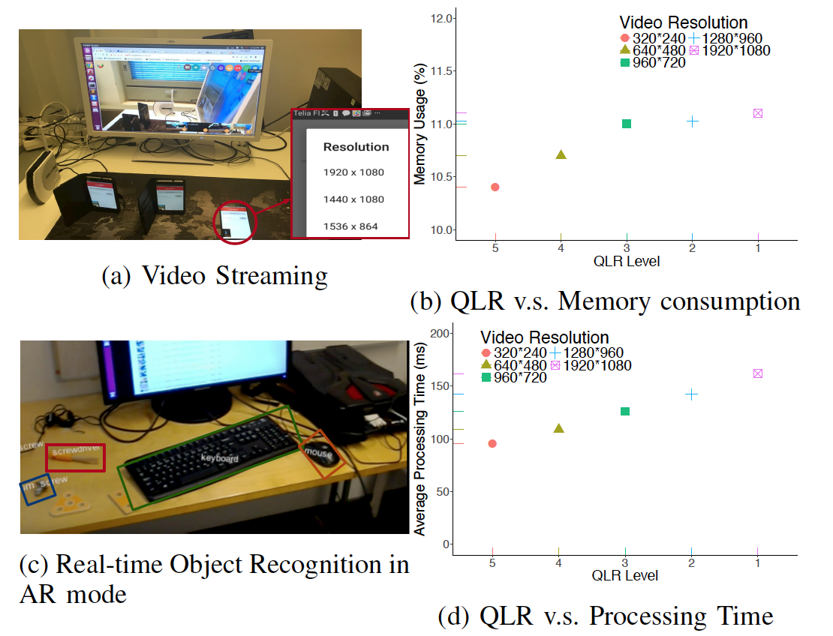
Application Profiling
Notes:
Here, we implement two applications. One is video streaming appication, which is a WebCamera-based real-time video conference. We ran the application on a Linux desktop server and three androind phone clients. The client application captures video and sends it to the server. We test 5 different video resolutions, from 240p to 1080p and measure the memory usage of the server. Here, we consider the video resolution as the service quality, which is q_k. And the memory usage as the resource consumption, which is R(q_k). In the figure, we can see the memory usage and the service quality have a near-linear relationship. Furthermore, we implement a real-time object recognition application based on Yolo and test the processing time with various video resolution under same criteria. We get the results shown in figure, we can see the processing time, which is P(q_k) and the video resolution, which is q_k also have a near-linear relationship.

Slide 15
Problem Formulation
Still Non-linear
Notes:
However, the problem still is non-linear. Because x-jk and q-k are coupled together.

Slide 16
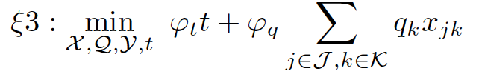
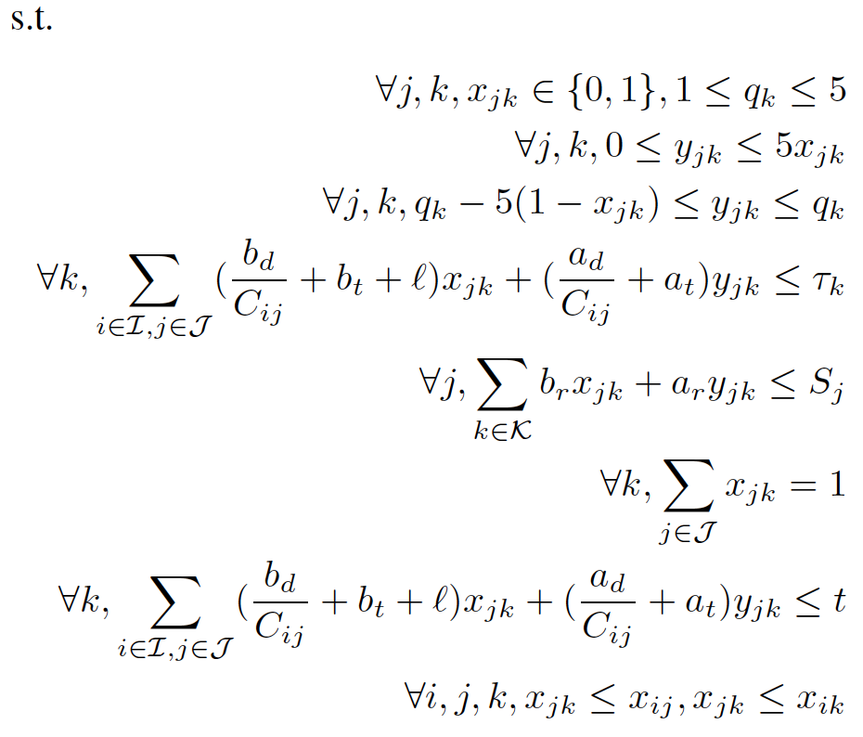

Problem Linearization
Notes:
We add a new variable which is y_jk equal to the product of x_jk and q_k. Then, we can get the linear problem as listed.

Slide 17
Put all in a MILP solver…
Notes:
Now, we can put the problem into a mix-integer linear programming solver, which called MILP, for the demand results.

Slide 18
Workflow of MILP
Notes:
Here is the workflow of MILP solution. The input of MILP solver is the information of client vehicles and fog nodes. The output of MILP solver are the assignment decision and quality selection for each task.

Slide 19
How to address the mobility of vehicles?
Notes:
However, in VFC, the clients and servers are moving around. The communication would break when two vehicles are two far away.

Slide 20
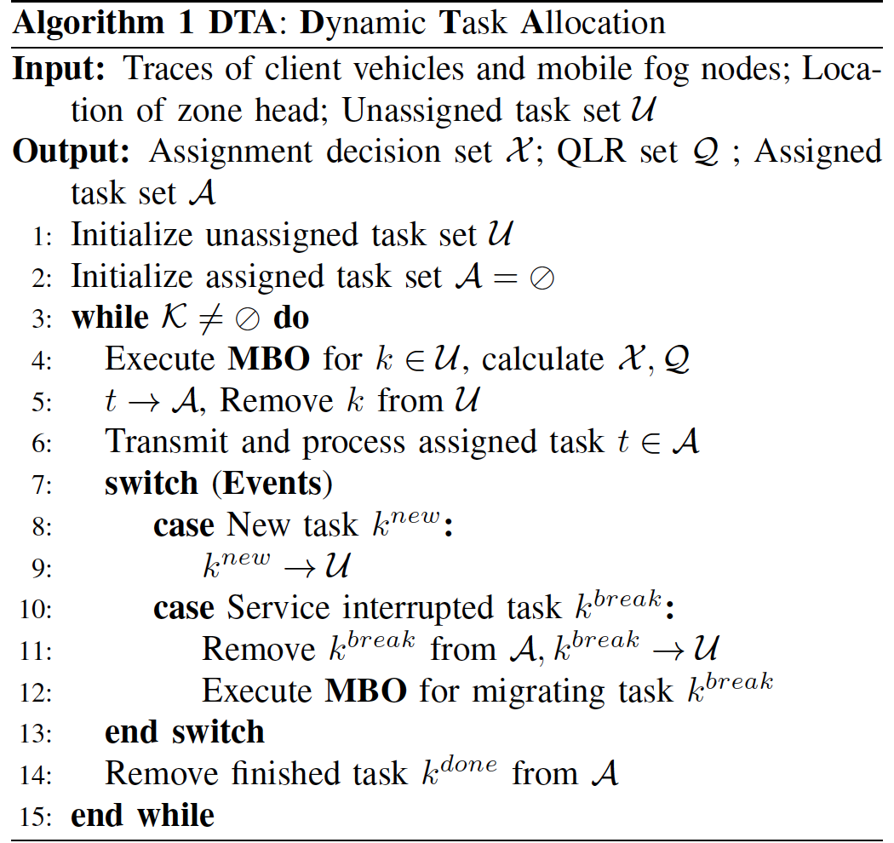
Dynamic Task Allocation
New Task Coming
Service Interruption
Notes:
Thus, we design a dynamic task allocation method, which is called DTA. The DTA is an event-driving method. It would conduct MILP solver again when there are new task coming or a service interruption occurs.

Slide 21
What’s the performance of access technologies?
Notes:
So, another question, what’s the performance of current vehicular access technologies.

Slide 22
Access Technologies Simulation
Notes:
In vehicular networking. DSRC and LTE are two popular access technologies. Here, We an inter-vehicle communication simulator, veinsLTE to test the performance of LTE and DSRC. In veinsLTE, each vehicle equips DSRC stack and LTE stack.

Slide 23
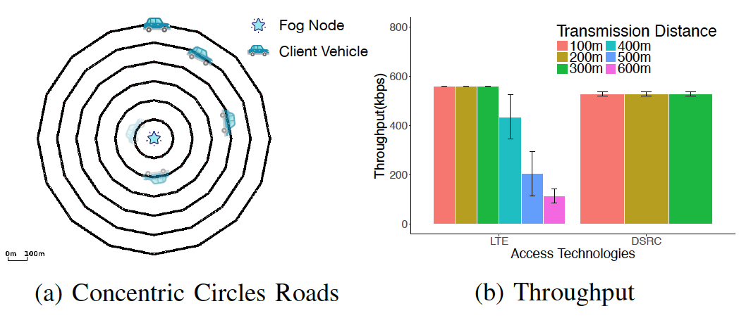
Access Technology Performance
Notes:
We build 6 near round concentric roads. Each road contains two lanes, and the distance between the neighboring roads is 100 meters. As shown in Figure, we place one fog node in the center of the concentric roads, and add a video streaming module to the application layer of a client vehicle in VeinsLTE. The client vehicle moving at speed of 20m/s is continuously sending video data to the fog node in the center. By settling the client vehicle onto different roads, we could measure the throughput of video streaming with varying communication distance.
As shown in Figure , we can see the throughput of DSRC decrease with the increase of communication distance. Different from DSRC, the throughput of LTE do not have a strong relationship with communication distance.

Slide 24
Does our scheme work in real-world scenario?
Notes:
Then, does our scheme work in real-world scenario?

Slide 25
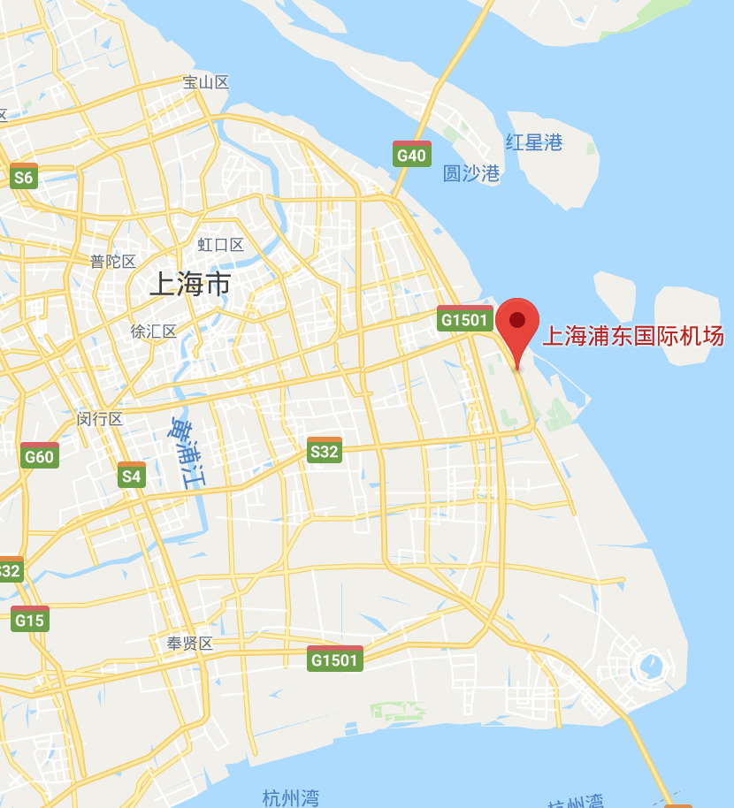
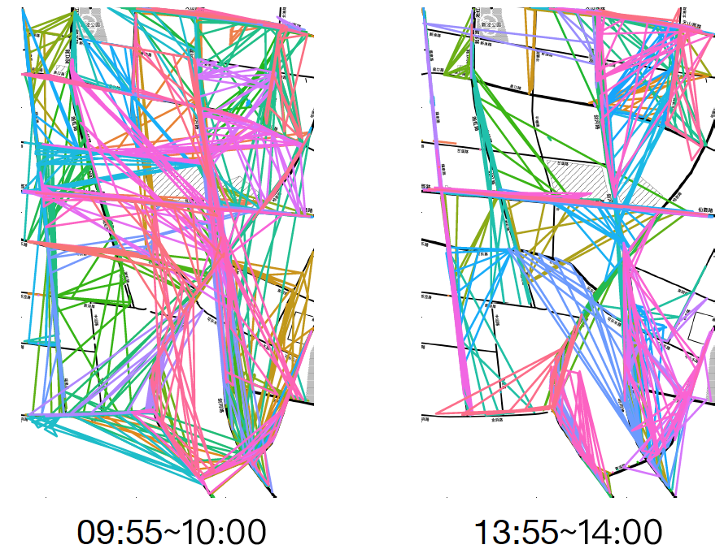
Dataset
Notes:
To test the performance of Folo, we use a real-world dataset of taxi GPS of Shanghai. We select an area of 4 km2 acreage near Shanghai Pudong Airport, and collect the traces within the area during two time periods, which are 09:55~10:00 and 13:55~14:00. We can see the difference of traffic density as shown in listed figure.

Slide 26
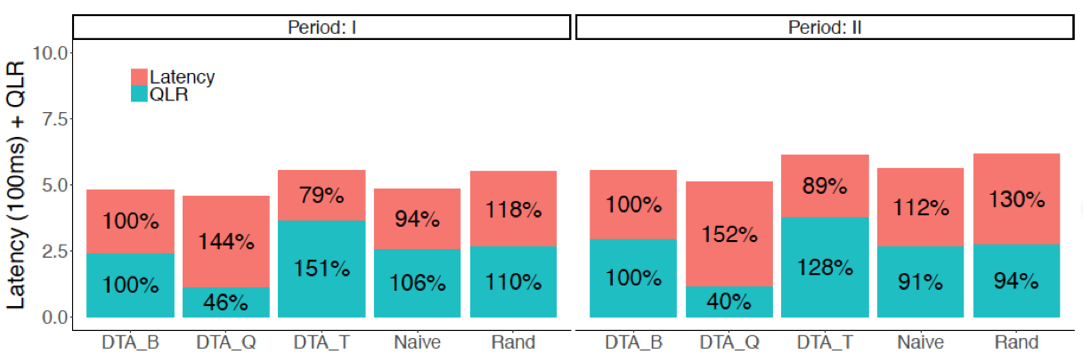
Evaluation Results
Balanced
Quality Oriented
Latency Oriented
Notes:
Here is the performance of our proposed solution. We select two task allocation scheme as the reference methods, naïve and random. The naïve means the client vehicle always select the mobile fog node with the closest distance as the task server. The random means the client vehicle randomly select a fog node as the task server. Furthermore, we also design three task allocation with the variation of weight scalars of latency and quality, which are DTA_Q, focus on improve service quality, DTA_T focus on improve latency and a latency and quality balanced method called DTA_B. Here, we can see the DTA_T has shortcut the latency to 21% and the DTA_B reduce the quality loss upto 54%.

Slide 27
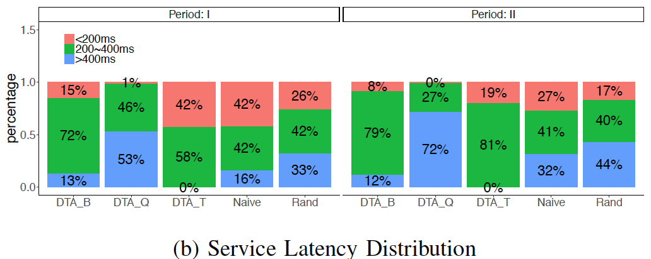
Evaluation Results
Notes:
Here is the distribution of service latency. We can see all the latency of DTA_T are with in 400ms.

Slide 28
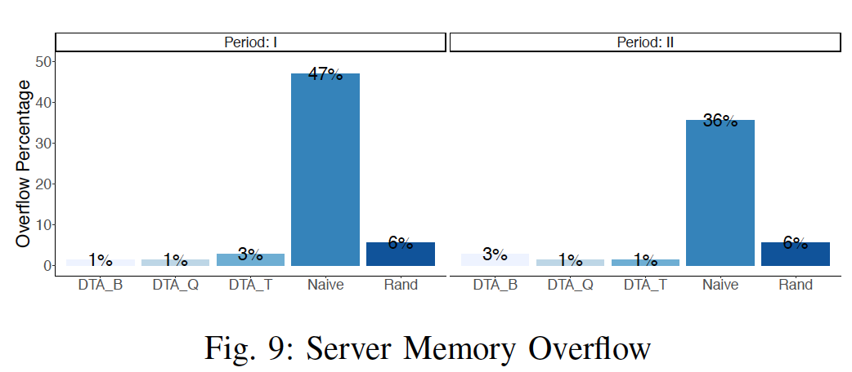
Evaluation Results
Notes:
Here is the memory overflow of different methods. We can all the DTA based methods outperform the Naïve and random methods.

Slide 29
Summary
Dynamic task allocation for VFC
Application profiling
Real-world dataset simulation

Slide 30
Any question?

