Slide 1
SteerTrack: Acoustic-based Device-free Steering Tracking Leveraging Smartphones
Xiangyu Xu*, Jiadi Yu*, Yingying Chen†, Yanmin Zhu*, Minglu Li*
*Dept. of CSE, Shanghai Jiao Tong University
†Dept. of ESE, Rutgers University
Notes:
Hi, I am Xiangyu Xu from Shanghai Jiao Tong University.
Today I am going to talk about how we realize steering tracking using audio devices on smartphones.
%This is joint work with professor Yingying Chen in Rutgers University

Slide 2
Outline
Motivation
System Design
Acoustic Signals Processing
Hand Movement Tracking
Steering Wheel Angle Estimation
Evaluation
Conclusion
Notes:
This is the outline of the presentation.
I will first introduce the background and motivation of this work.
Then, I will present the detailed system design.
After that, I will show the evaluation results, and finally conclude this work.
First, let's take a look at the motivation.

Slide 3
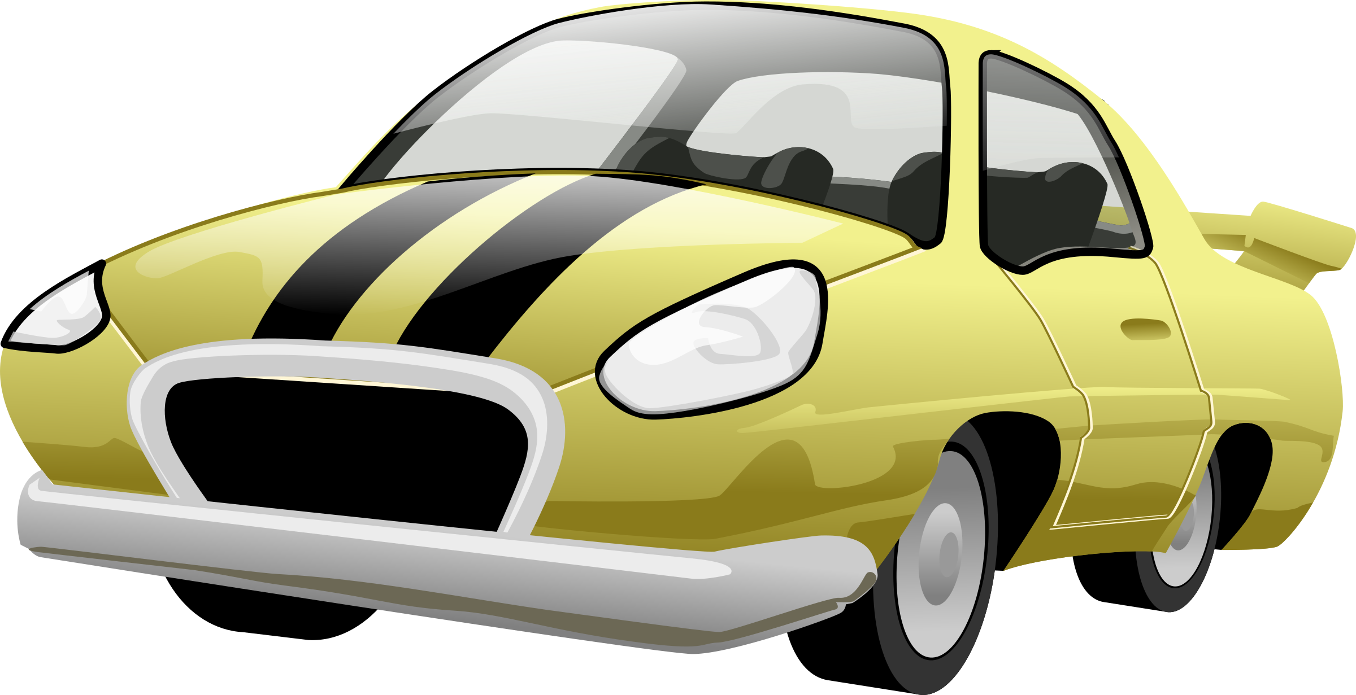
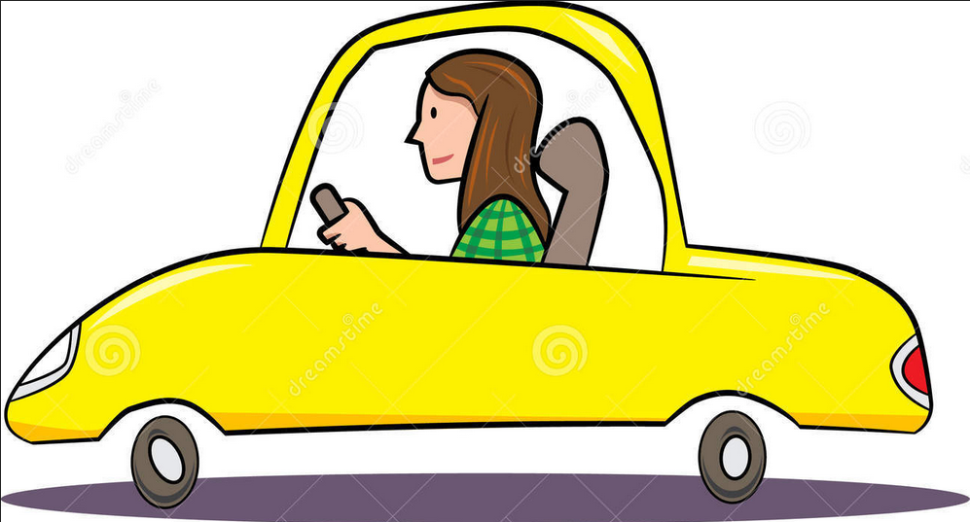
Monitoring Systems for Driving Safety
Monitoring the vehicle dynamics
Monitoring the vehicle dynamics
Speed
Main Problem:
limited in providing time-sensitive information
Turning
Lane-changing
……
Monitoring the driving behaviors
Main Problem:
can not quantitatively relate the behaviors of drivers to vehicle conditions
Normal
Drunk
Fatigue
……
Notes:
For improving driving safety，many methods have been proposed in recent decades to monitor the driving.
Some of them focus on monitoring the vehicle dynamics, the main issue is that the danamic information is delayed. If a vehicle is in wrong dynamics, it may not be changed timely
Other works focus on monitoring the driving behaviors, while the problem is that we can not accurately relate the behaviors of drivers to vehicle conditions, the information is rather limited

Slide 4
Steering Tracking
Driving behaviors
Vehicle dynamics
Normal
Turning around
Drunk
Turning
Fatigue
Lane-changing
……
……
Steering Information
Over-Steering
Under-Steering
……
Notes:
To overcome the shortcomings, in this work, we focus on the steering tracking, which turns the driving behaviors to the vehicle dynamics, so both information can be inferred,
meanwhile, it provides extra steering information, including…
So it is meaningful to track the steering of vehicles

Slide 5
Outline
Motivation
System Design
Acoustic Signals Processing
Hand Movement Tracking
Steering Wheel Angle Estimation
Evaluation
Conclusion
Notes:
Now let's take a look at the design of our system.

Slide 6
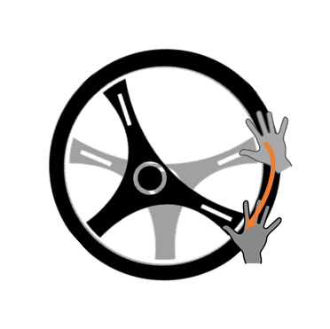
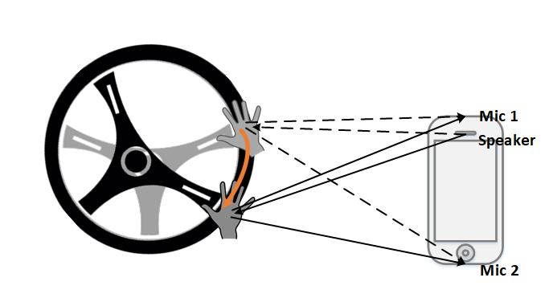
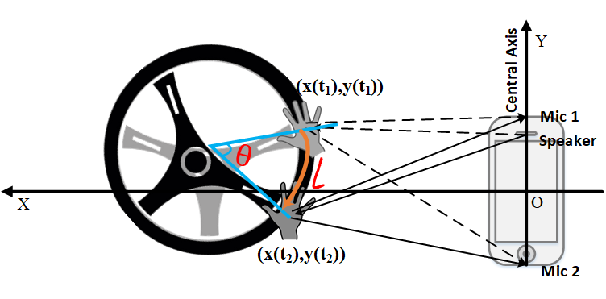
Basic Idea
Leverage acoustic signals to track movements of the a driver’s hands
Estimate the steering wheel angle based on the hands trajectory
Problems:
Acoustic signals suffers from multi-path in real driving environments
Drivers have different steering maneuvers
The steering wheel and the smartphone are not in the same plane
Notes:
The basic idea of steering tracking is using acoustic signals to track movements of drivers hand.
Then calculate the steering wheel angle according to the trajectory
So, given a hand turning the steering wheel, we use the speaker and two microphones to build a 2-D coordinate system, and further calculate the steering wheel angle
However, there remains some problems.

Slide 7
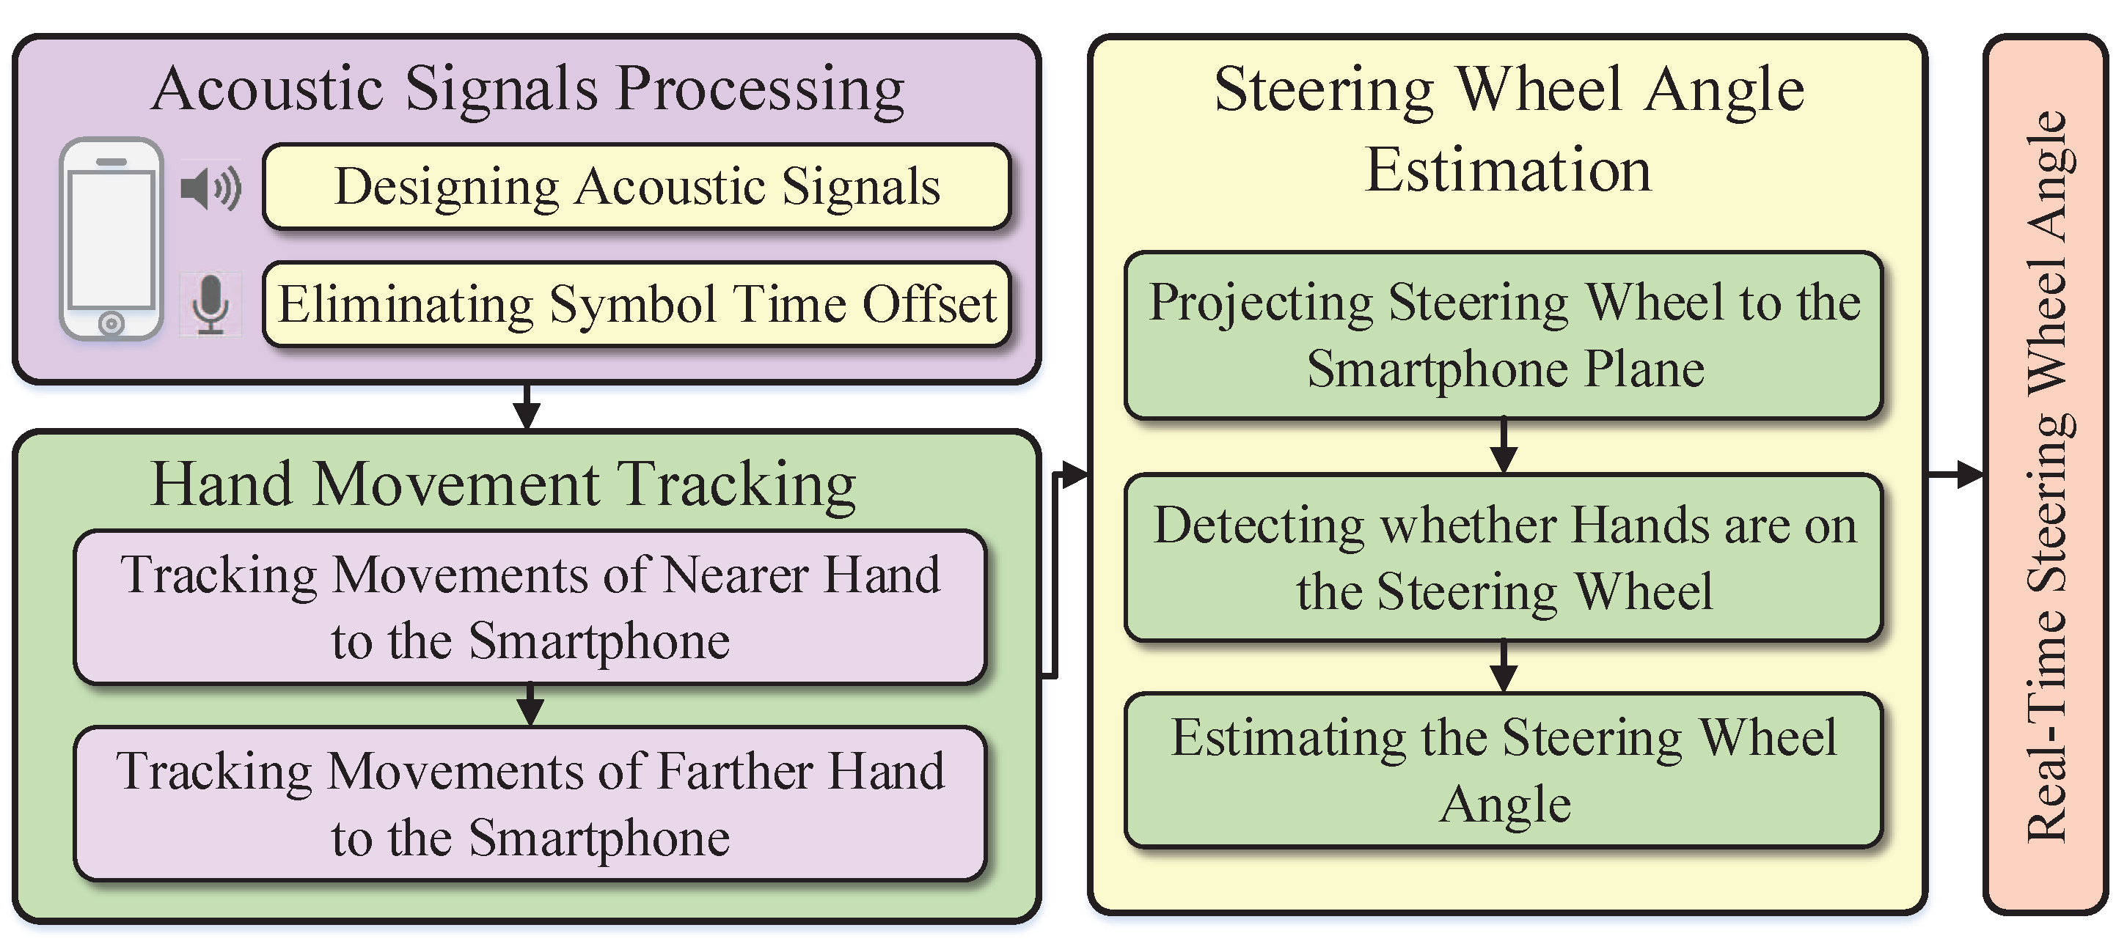
System Architecture
Notes:
Then we show the architecture of SteerTrack, which can be divided into three parts.
First is about how we design and process the acoustic signals
Second is about how we track the both hands of a driver using acoustic signals
Third is about how we estimate the steering wheel angle using the trajectory of hands

Slide 8
Outline
Motivation
System Design
Acoustic Signals Processing
Hand Movement Tracking
Steering Wheel Angle Estimation
Evaluation
Conclusion
Notes:
First let’s look at the acoustic signal processing part

Slide 9
Acoustic Signal Design
Transmitting End:
Symbol
Separation
Cyclic Prefix (CP)
Receiving End:
A pair of sliding windows
Eliminate the Symbol Time Offset(STO)
Notes:
In the transmitting End, we made the acoustic signal as symbols modulated by a carrier of 20kHz, then we repeatedly send the symbol, but with a separation so that the reflected signal of current symbol may not be interfered by next symbol.
Specially, we add an Cyclic prefix at the beginning of each symbol, and it will be used in the processing of receiving end
For the receiving end we build a pair of sliding windows to calibrate the receiving signal and eliminate the symbol time offset and find the beginning of each symbol in the receiving end

Slide 10
Outline
Motivation
System Design
Acoustic Signals Processing
Hand Movement Tracking
Steering Wheel Angle Estimation
Evaluation
Conclusion
Notes:
Then we show how to track the hand movement of drivers

Slide 11
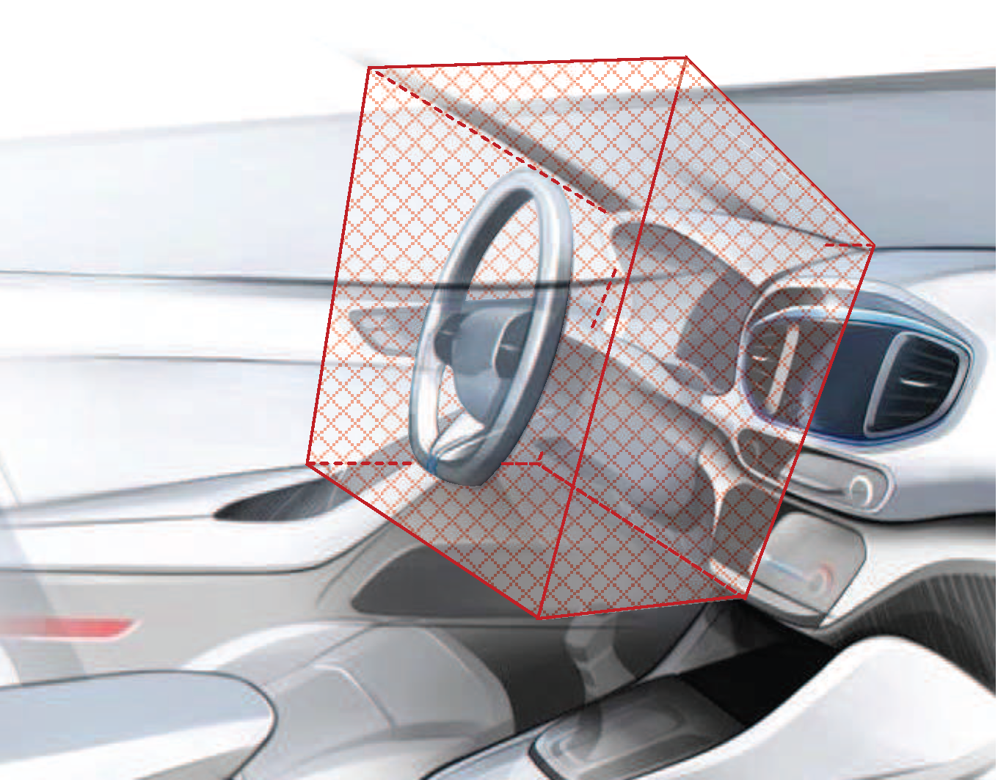
Assumptions
The hands of drivers are the nearest moving objects with respect to the smartphone.
Requiring the smartphone to be in a certain area:
With a co-pilot
Without a co-pilot
Separate the hands of a driver to nearer hand and farther hand
Notes:
Before moving on, we need to make several assumptions,
First is, the hands of drivers are the nearest moving objects with respect to the smartphone, it is practicable by placing the smartphone in a certain place
Second, we separate the hands not by left or right, but by the distance to the smartphone, in this case, the nearer hand and the farther hand

Slide 12
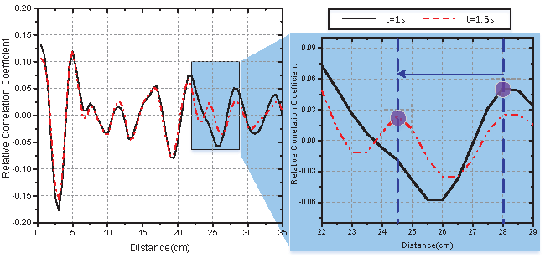
Nearer Hand Tracking
Defining relative correlation coefficient (RCC) to capture the movements of surrounding objects
The first moving peak is corresponding to the movement of nearer hand
Notes:
We Define the relative correlation coefficient (RCC) to capture the movements of surrounding objects, which is equal to the correlation coefficient times signal strength coeiffient
If all the objects are static, the peaks will not move
While, if an object moves, in this case, a hand of the driver, then the corresponding peak starts to move

Slide 13
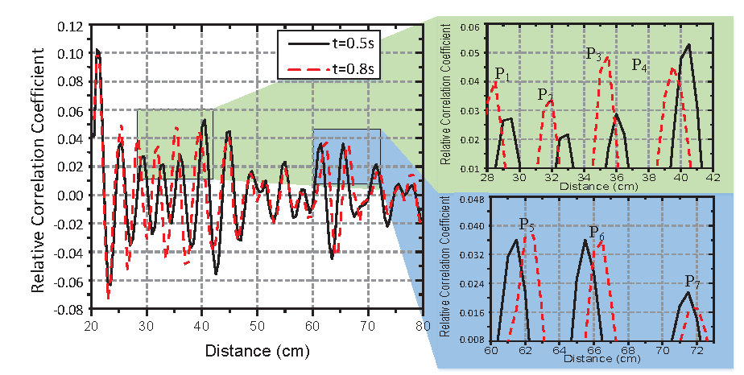
Farther Hand Tracking
Compute Distance Difference Sequence (DDS) of each moving peak
Compute the correlation of each DDS to the DSS of first moving peak
The first moving peak with correlation less than a threshold is corresponding to the movement of farther hand
Notes:
In the case of two hands, we try to remove the peaks corresponding to the nearer hand, and remains the peaks of farther hand.
Specifically, we Compute Distance Difference Sequence of each moving peak and compare them to the first peak,
If they are highly related, then the peak belongs to the nearer hand, if not, then it may not corresponds to the nearer hand.
We take the first moving peak which is not corresponding to the nearer hand as the movement of farther hand.
With 2 microphones and a speaker, we can track both hands of a driver in a 2-D plane

Slide 14
Outline
Motivation
System Design
Acoustic Signals Processing
Hand Movement Tracking
Steering Wheel Angle Estimation
Evaluation
Conclusion
Notes:
Then, we take a look at Steering Wheel Angle Estimation

Slide 15
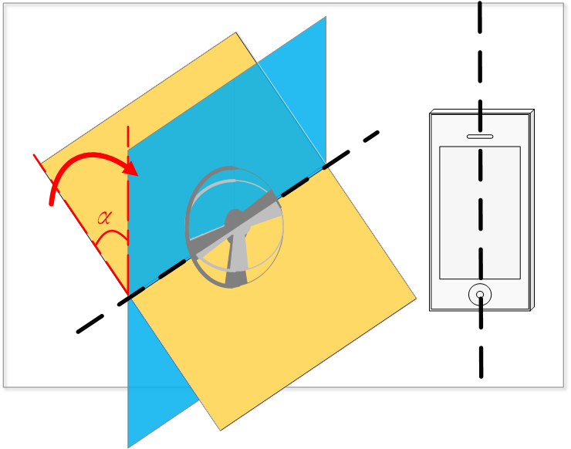
Project Steering Wheel to Smartphone Plane
Original Steering Wheel:
First Transformation:
Notes:
Since the steering wheel is not in the same plane as the smartphone, we need to figure out what is the steering wheel like from the view of the smartphone.
In other words, we project the steering wheel to the smartphone plane.
First, we formulate the steering wheel as a circle in its own plane, then we rotate the plane along the x-axis until the plane is Parallel to the central axis of the smartphone and get to the intermediate plane
Give the angle to be alpha, then the formulation of a circle turns to an ellipse in the intermediate plane

Slide 16
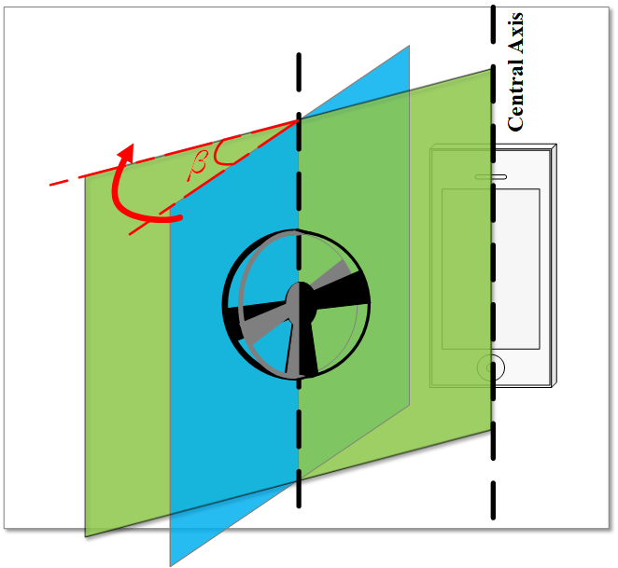
Project Steering Wheel to Smartphone Plane
Second Transformation:
The projection is an ellipse
Problem:
Can not obtain parameters and
Notes:
After that, we further rotate the intermediate plane along the y-axis until the plane go through the central axis of the smartphone, and get to the smartphone sensing plane.
Similarly, given the angle as beta, we can get the formulation of the steering wheel in smartphone plane
We can observe that the projection is an ellipse, however, we can not get the formulation because both alpha and beta are unknown and very hard to be obtained

Slide 17
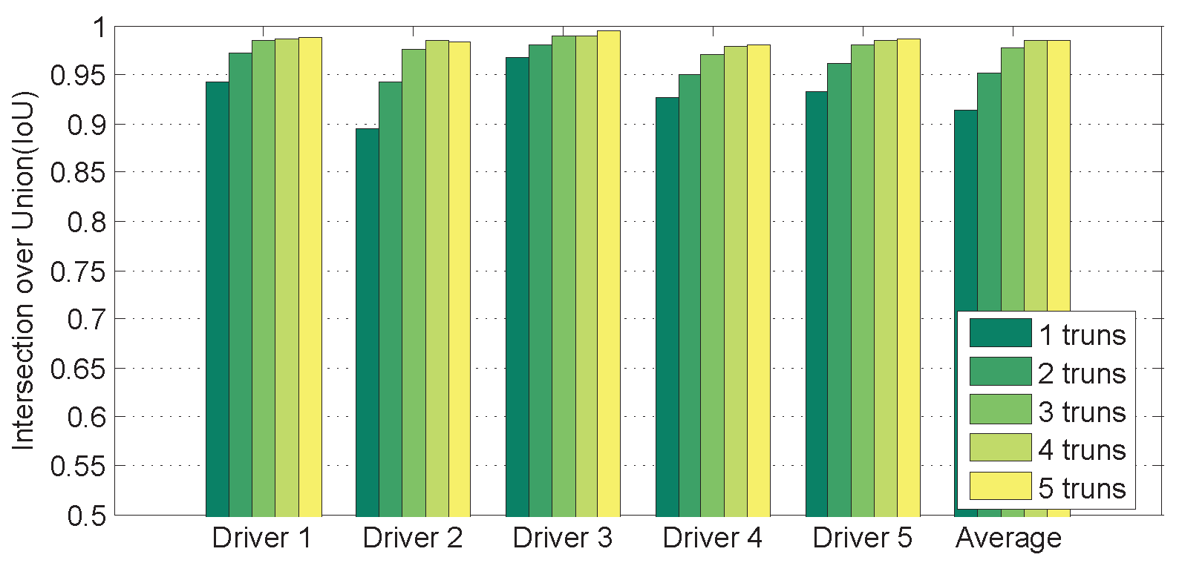
Construct the Ellipse
Formulate the ellipse:
Fit the ellipse through least square fitting:
With more than 5 points on the ellipse
Leveraging turns at the beginning of driving
Notes:
Therefore, we set the formulation of the projection as a normal Equation of an ellipse.
And fit the ellipse using least square fitting.
Concretely, we collect points when driver making turns at the beginning of driving, and then fitting the ellipse with collected points.
It can be seen that after a few turns, the fitted ellipse is very close to the baseline ellipse, here we use IoU as a metric, which is widely used in object detection area

Slide 18
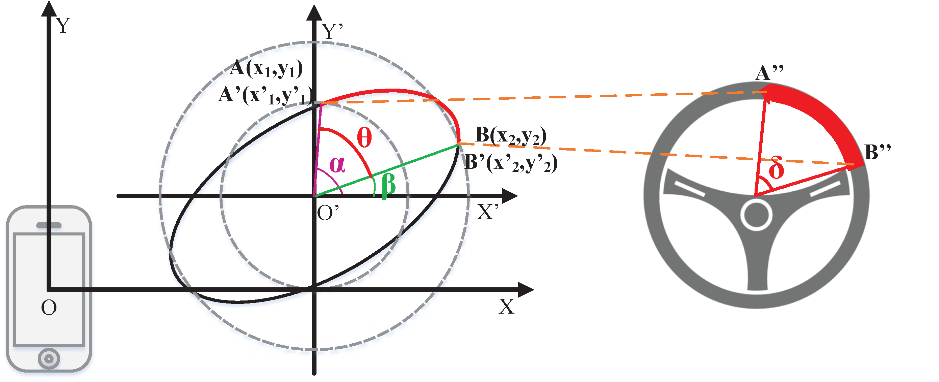
Estimate Steering Wheel Angle
Changing the origin:
Calculate the steering wheel angle leveraging central angles
Notes:
Finally, after we get the formulation, we change the origin from the smartphone to the center of the ellipse projection, and calculate the steering wheel angle leveraging central angles,
Note that the angle in the ellipse projection can be taken as the angle of real steering wheel since we only takes linear transformations

Slide 19
Outline
Motivation
System Design
Acoustic Signals Processing
Hand Movement Tracking
Steering Wheel Angle Estimation
Evaluation
Conclusion
Notes:
Let’s move on to the evaluation of our steering tracking system

Slide 20
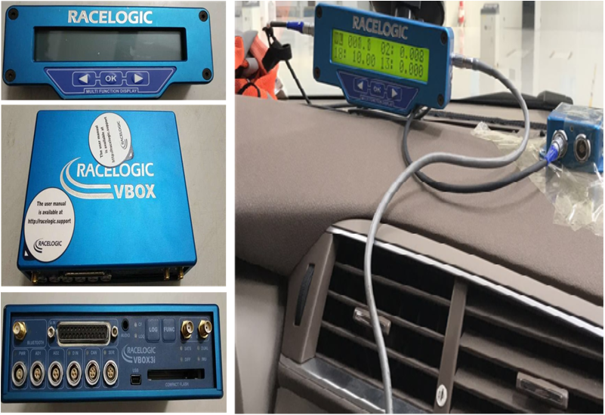
Experiment Setup
Testing Dataset:
5 volunteer drivers and their own vehicles;
5 smartphones of 5 types installing SteerTrack systems on smartphones;
Ground truth is collected by a special T-box as shown on the right;
Collecting the steering angle at turns;
Six weeks: 5th May, 2017 to 25th June, 2017;
Totally 5001 samples for evaluation.
Google Pixel, HTC U Ultra, Samsung Galaxy S6, LG G4 and Huangwei Mate8
Notes:
To build our dataset for evaluation, we collect the data from 5 volunteer drivers by placing smartphones with SteerTrack apps in their own vehicles, and we install a special T-box in each vehicle to collect the ground truth.
To make the evaluation convenient, we collecting the steering angle at turns.
It lasts for 6 weeks to collect about 5 thousand samples.

Slide 21
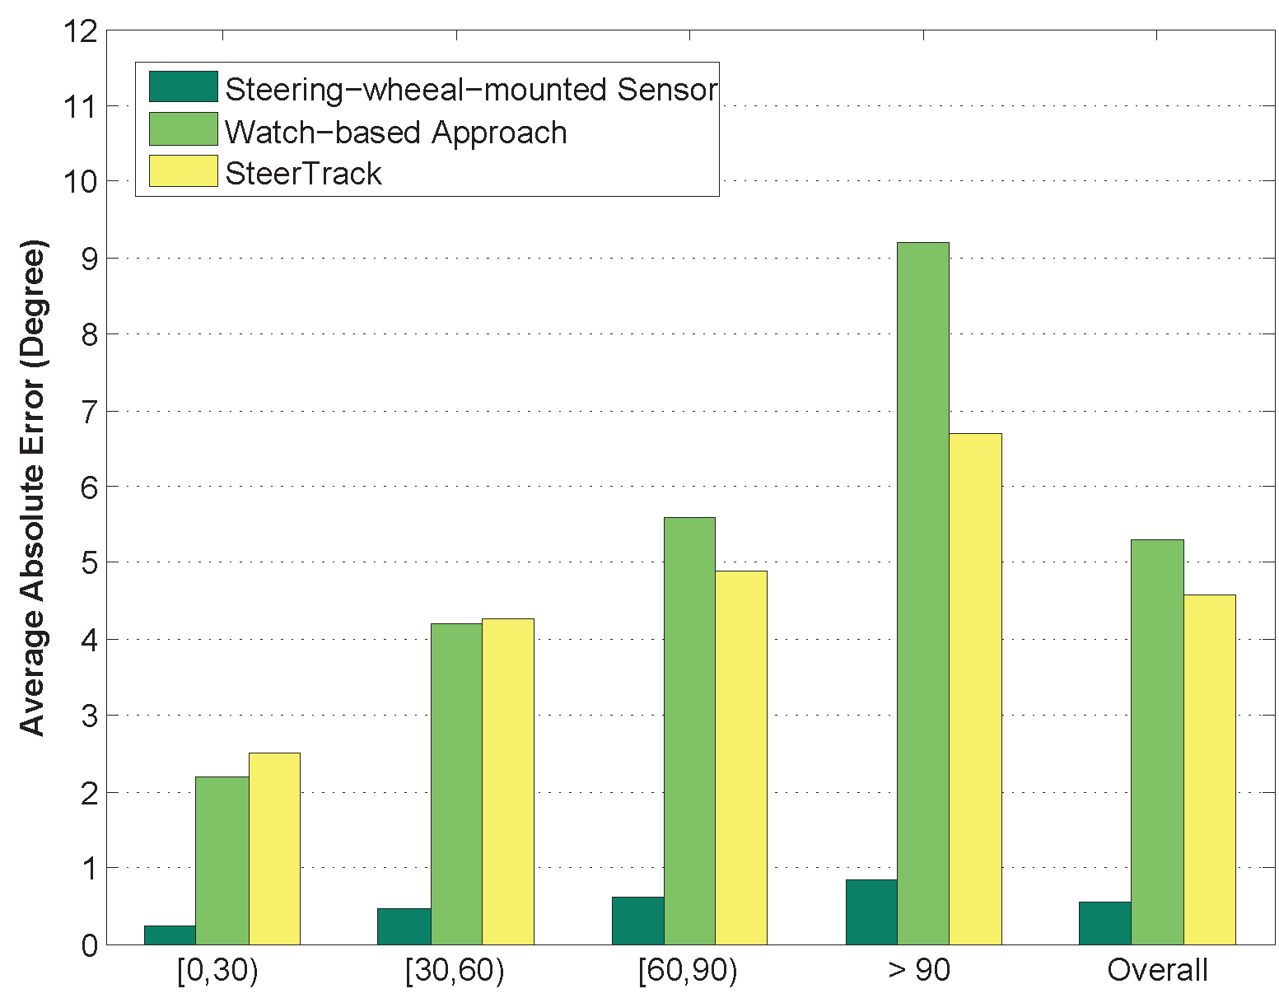
Steering Monitoring
Overall performance comparing to different methods
Notes:
First，we can see the absolute error of SteerTrack for estimating the steering wheel angle compared to other methods.
The left is to place a special sensor on the steerwheel, which is best, of course.
The middle one is a smart-watch-based method, it can be seen that when the turns are of small range, SteerTrack and the smartwatch-based method get similar performace, but when the angle becomes larger, SteerTrack is much better, drivers tend to use both hands to steer during large turns, which can not be captured by the smartwatch

Slide 22
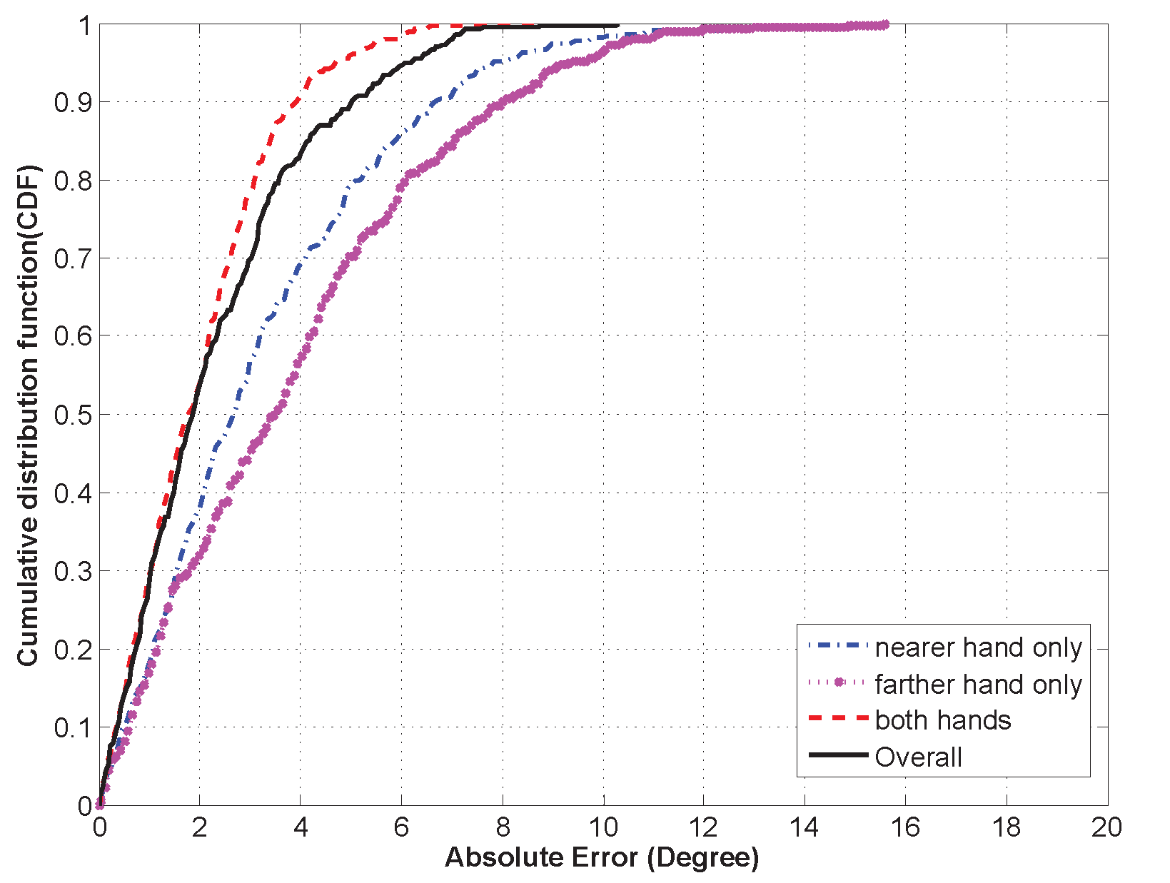
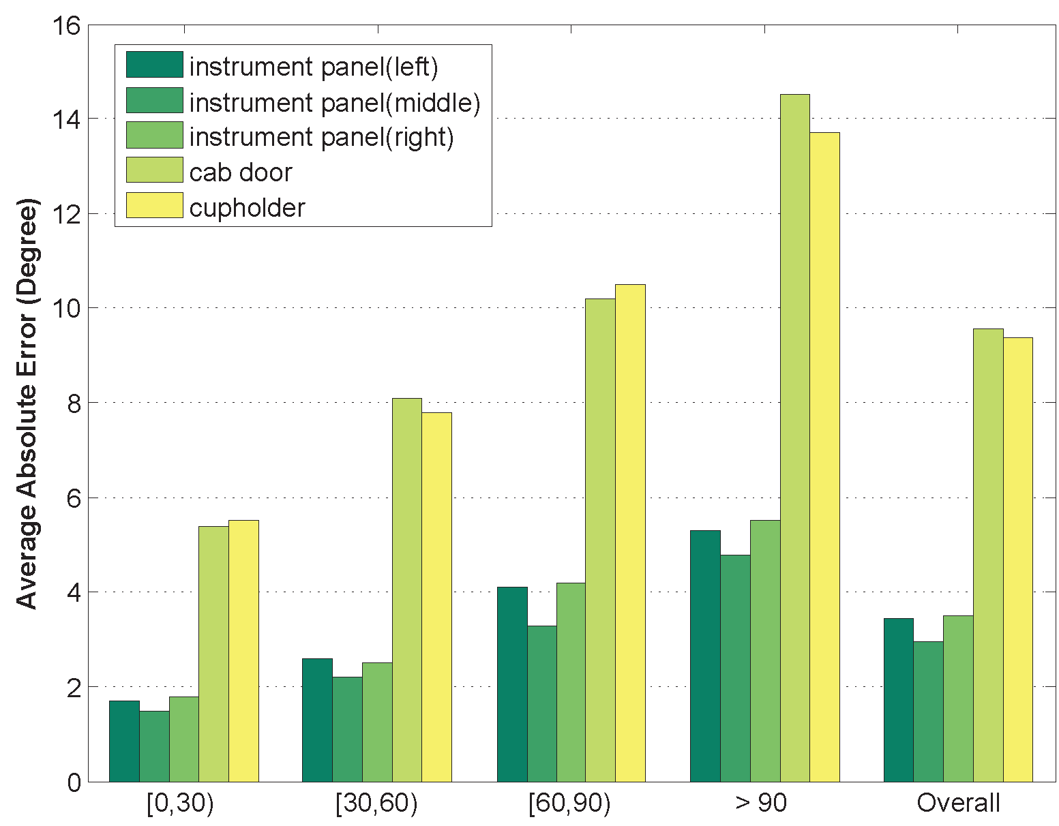
Steering Monitoring
Performance of different steering maneuvers
Performance of different smartphone locations
Notes:
Then we show the performance over different steering maneuvers and different smartphone locations
For steering maneuvers , both hands is of best performance, while using farther hand only are slightly worse.
For smartphone locations, placing the smartphone in the certain area achieves good performance, while placing the smartphone in other places are worse, since it breaks the assuptions

Slide 23
Outline
Motivation
System Design
Acoustic Signals Processing
Hand Movement Tracking
Steering Wheel Angle Estimation
Evaluation
Conclusion
Notes:
Ok, lets conclude that talk.

Slide 24
Conclusion
Design a steering tracking system, SteerTrack, through a smartphone App
Leveraging audio devices in smartphone – without additional hardware
Computationally feasible on off-the-shelf smartphones
Demonstrated the viability through experiments in real driving environments
SteerTrack achieves an average total accuracy of 4.61 degree for estimating the rotation angle of steering wheel
Future Work
Relax the limitation of smartphone location
Notes:
In this work,
1.We design a steering tracking system, SteerTrack, through a smartphone App.
2.And we show that SteerTrack, can estimate the steering wheel angle effectively in real driving environments
As for future work, we tend to relax the limitation of smartphone location

Slide 25
Thank you!
Q & A
Notes:
That’s all
Thank you for listening!
Any questions?

