Slide 1

Combating Tag Cloning with COTS RFID Devices
Xingyu Chen, J. Liu, X. Wang, X. Zhang,
Y. Wang, L. Chen
June 12, 2018
Notes:
Good afternoon, everyone. My name is Xingyu Chen. From Nanjing university, China.
Thank you for attending my presentation. Our work is combating Tag Cloning with COTS RFID Devices.

Slide 2

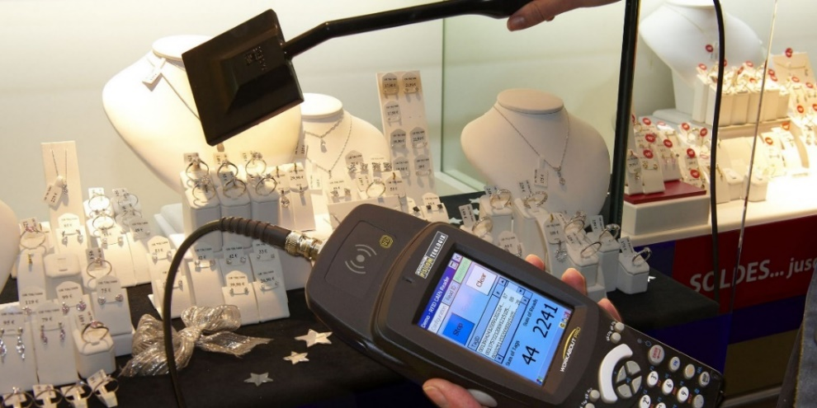



Motivation
Credit cards
Passports
product identification
Infant security
Notes:
Tag cloning is one of the most common security attacks in RFID systems.
For example, if a tag is cloned in a supply chain, the fake tagged products may be treated as the true ones, which causes financial loss.
In another example, if a baby tag is cloned, the same data can also be reported by
clone tags even though the tagged baby leaves the room, which threaten baby security.
So, detecting tag cloning is very important.

Slide 3
New Findings
Genuine tag
Clone tag
Existing solution
Genuine tag
Clone tag
In practice
Notes:
In Existing solutions, they assume that the genuine tag and its clone tags will always reply in the same slot. By detecting the tag collision, the reader can find the clone tags. However, in our experiments, we find that this assumption does not hold. In other words, they may reply in different slots. This makes existing works failure to detect tag clone.

Slide 4
Clone Detection
Step 1.
K
Still Scene
Step 2.
Dynamic Scene
Notes:
In this paper, we identify any clone tags with the commercial RFID devices.
We discuss two cases: still scene and dynamic scene.

Slide 5
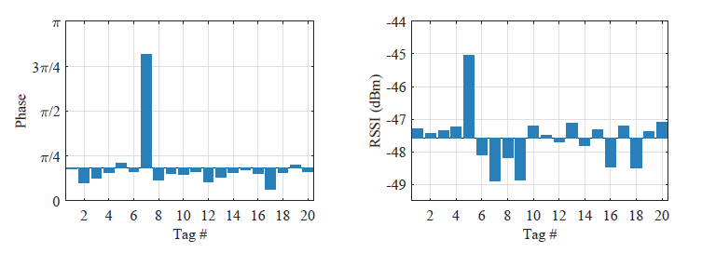
Basic idea
Phase
RSSI
20 different tags located at the same position
Notes:
The basic idea is that, although the application-layer data, such as tag ID, can be easily cloned, the physical-layer data (e.g., RSSI and RF phase) can hardly be done. As shown in these figures, different tags will have different phase values and RSSI even they are located at the same position.

Slide 6
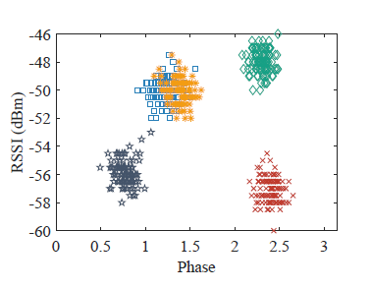
Clone Detection in Still Scene
1 Genuine tag + 4 Clone tags
Data from one tag
RSSI-phase profile
Notes:
So we can use the RSSI and phase value to detect clone tags.
Consider one genuine tag and four clone tags. We plot their RSSI-Phase profile. As we can see, there are five clusters in this figure. We can use the classic clustering method to find the number of clusters, so does the number of tags.

Slide 7
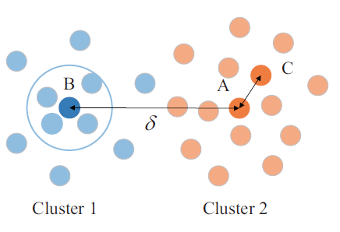
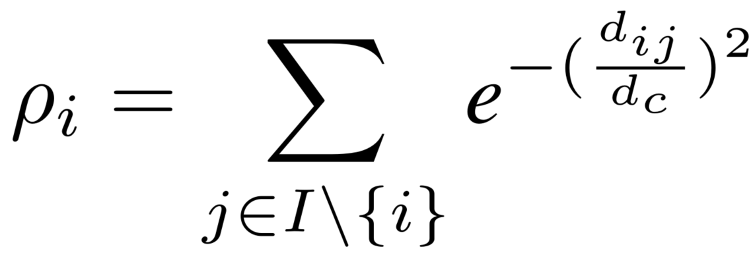

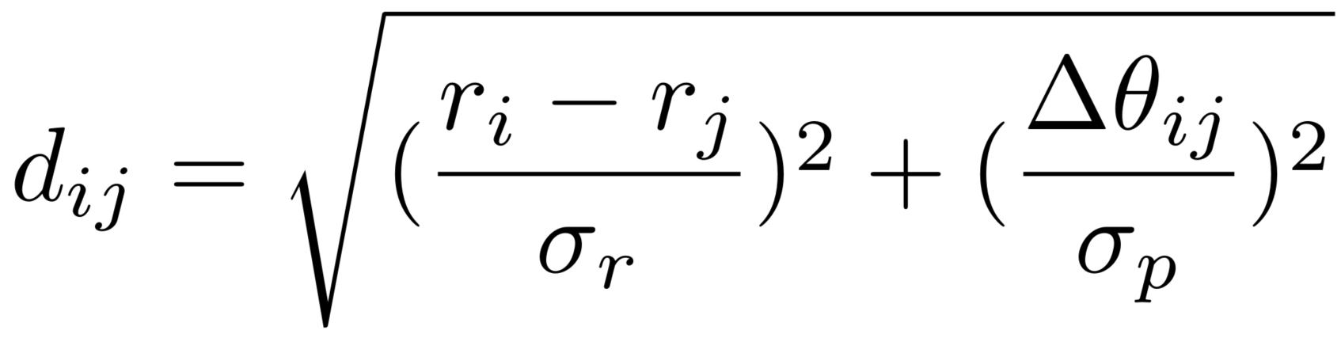


Density-Based Clustering Algorithm
Density
Notes:
In density based clustering algorithm, the clusters are areas of high density. We use the first function to get the density of each point. We take the point with the highest density in a cluster as the center. For example, A will be treated as the center of a cluster because it has the highest density. However, for the remaining points, C will be treated as a center. We cannot treat it as the center because A and C are too close and they are from same cluster. We than propose clustering distance to handle this problem.

Slide 8
Density-Based Clustering Algorithm
Density
Distance
Notes:
For a point, the clustering distance is the minimum distance between this point and the points with higher density. In the above example, the clustering distance of point C is AC, this distance is very small and can lower the probability of c to be a center.

Slide 9
Density-Based Clustering Algorithm
Density
Distance
Weight
Notes:
To take a joint consideration of the two metrics, we use the product of density and clustering distance as the weight of each point.

Slide 10
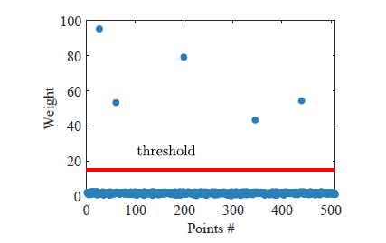
Density-Based Clustering Algorithm
Density
Distance
Weight
Notes:
Clearly, there are five points that have much higher weight than other points. This result is just the same as the ground truth.

Slide 11
Clone Detection
Step 1.
K
Still Scene
Step 2.
Dynamic Scene
Notes:
Than we discuss the dynamic scene

Slide 12
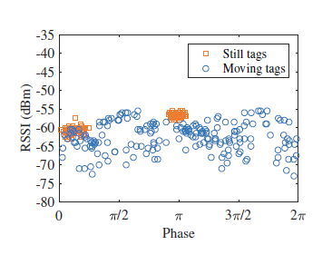
Basic idea
2 Still tags + 2 Moving tags
High density
Continues in the time domain
Notes:
Consider two still tags and two moving tags. As shown in this figure, it seems that the data are much chaotic. But there are two clues can help us deal with the dynamic scene. First, the data from static tags still have high density, we can find the number of static tags by the above density based algorithm. Second, for moving tags, the physical layer data from one tag are continues in the time domain. With these observations, we try to respectively count the number of still tags and moving tags.

Slide 13
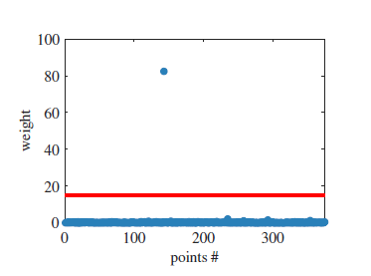
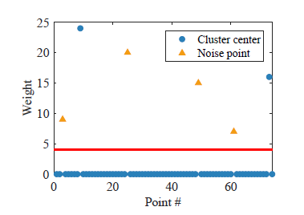
Still Tags
Long run vs short time window
Keep still in all time windows
Random distribute in different windows
Notes:
We first try to get the number of still tags. The left is the weight from a long run. We can see that only one point has much higher weight but the ground truth is two. This mistake is cased by the impact of the chaotic data from moving tags. To lower this impact, we run our method in a short time window. In this case, All centers have been chosen but there are many noise points from moving tags. In experiment, we find the centers’ positions of all windows are close to each other, the points occur in all time windows will be treated as centers. Now, we are able to get the number of still tags by counting cluster centers. We remove the points around these centers. The data remain are all from moving tags

Slide 14
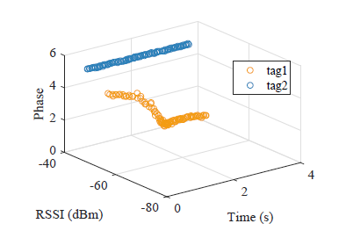
Moving Tags
Chains
3D RSSI-phase figure
Notes:
Than we try to get the number of moving tags. We further take the time into account and build 3D RSSI-phase figure. From this figure, we can find that the data from one moving tag form a chain in this space. We can get the number of moving tags by counting the number of chains.

Slide 15
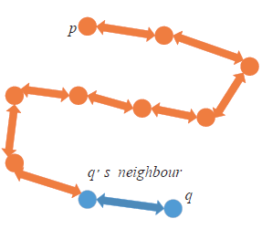
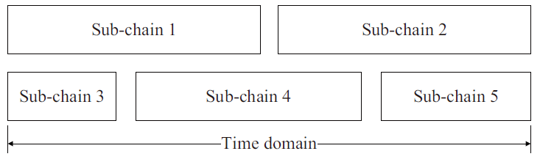
Moving Tags
Chains broken by data jump
Build chains
Connect sub-chains
Notes:
We next use an algorithm to get these chains. The basic idea is using all reachable points to form a chain.
However, By this way, more chains will be provided than ground truth. This mistake is cased by the data jump. To handle this problem, We connect the chains if their start time and end time are connected to each other. After this process, we can get the number of moving tags and finally get the number of clone tags in dynamic scene.

Slide 16
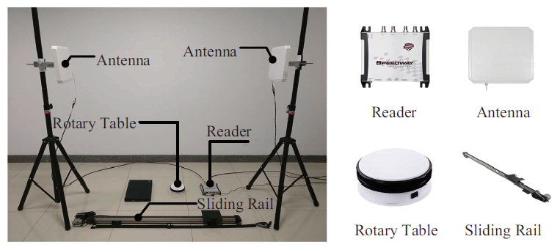
System Deployment
Notes:
This is the deployment of our work. We use the rotary table and sliding rail to change the motion of tags.

Slide 17
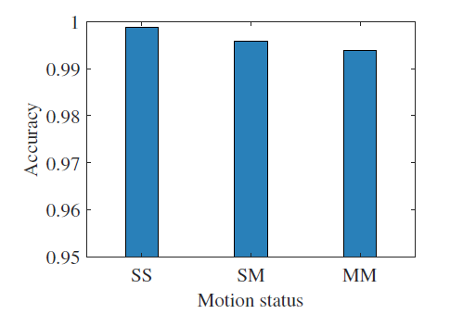
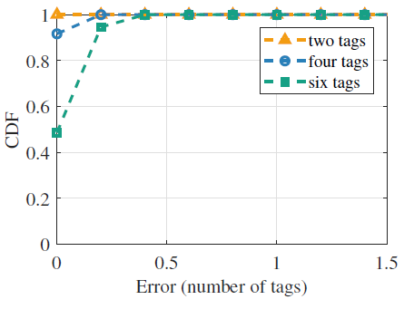
Performance
The detection accuracy reaches 99.3% even in a dynamic scene.
The counting errors are bounded in 0.2 tags.

Slide 18
Conclusion
1
We detect clone tags with COTS RFID devices
2
We provide two effective clustering strategies
3
The detection accuracy is high in practical
Notes:
Now we conclude our work.

Slide 19

Thank You!
Notes:
My presentation is over. Thank you!

