Slide 1
How Local Information Improves Rendezvous in Cognitive Radio Networks
Presenter: Yongqin Fu
Yongqin Fu*†, Yuexuan Wang*†, Zhaoquan Gu‡†, Xiaolin Zheng*,
Tianhao Wei*, Zhen Cao#, Heming Cui† and Francis C.M. Lau†
*Zhejiang University, Hangzhou, Zhejiang, China
†The University of Hong Kong, Hong Kong, China
‡Guangzhou University, Guangzhou, Guangdong, China
#Beijing University of Posts and Telecommunications, Beijing, China

Slide 2
Background
Wireless spectrum resource is limited.
Most parts of wireless spectrum have been allocated.

Slide 3
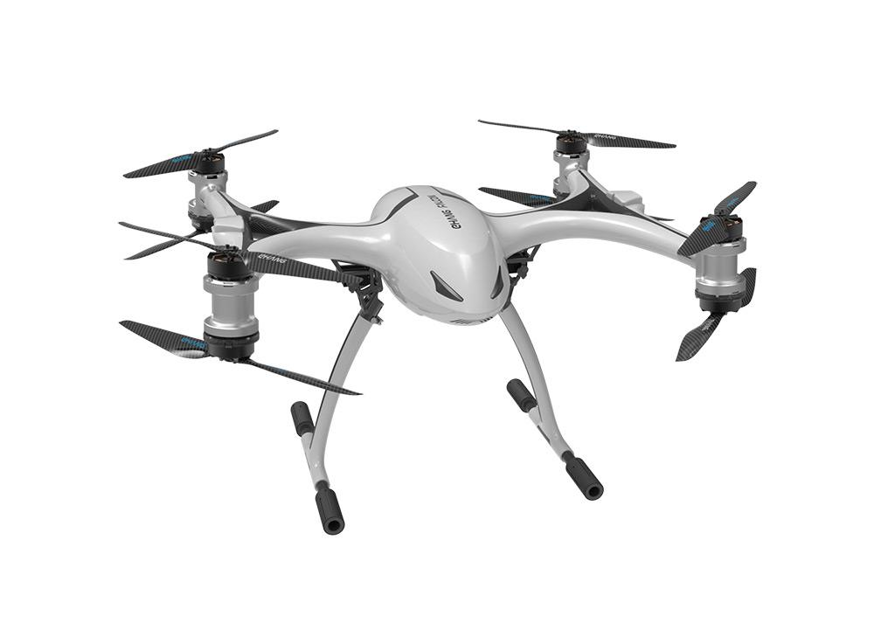
Background
Unallocated spectrum are becoming more and more crowded!

Slide 4
Cognitive Radio Networks
Cognitive Radio Networks (CRNs) have been proposed to alleviate
the spectrum scarcity problem.
Spectrums are divided into channels.
Users
PUs have the priority to use licensed channels over SUs.
CRNs enable SUs to use licensed channels when they are not being used by PUs.
Primary Users (PUs)
Secondory Users (SUs)

Slide 5
Rendezvous
Rendezvous is the fundamental process of CRNs.
Rendezvous aims at finding an available licensed channel for neighboring users to communicate.
Rendezvous algorithms contains centralized and blind algorithms.
Existing blind rendezvous algorithms can be divided into:
1. Synchronous or asynchronous; (global clock)
2. Anonymous or non-anonymous; (user ID)
3. Oblivious or Non-oblivious; (global channel labeling)
4. Global-sequence-based, local-sequence-based or semilocal-sequence-based.

Slide 6
Motivation
Although there have been many rendezvous algorithms proposed, there still exists room for improving in terms of Maximum Time To Rendezvous (MTTR).
Hence, we want to design rendezvous algorithms with lower MTTRs.

Slide 7
Problem Formulation
Denote the whloe set of channels in a CRN as U = {1,2,...,N}.
User i has an available channel set as Vi = {vi1, vi2, ..., vimi}
Problem 1: Design an asynchronous anonymous non-oblivious global-seuquence-based rendezvous algorithm with a low MTTR.
Problem 2: Design an asynchronous non-anonymous oblivious local-sequence-based rendezvous algorithm with a low MTTR.
Problem 3: Design an asynchronous anonymous non-oblivious local-sequence-based rendezvous algorithm with a low MTTR.

Slide 8
Math Basics
An important theorem that we used:
If m and n are co-prime numbers, then for any integer a, the integers a, a + n, a + 2n, ... , a + (m - 1)n are m distinct numbers under modulo-m arithmetic.

Slide 9
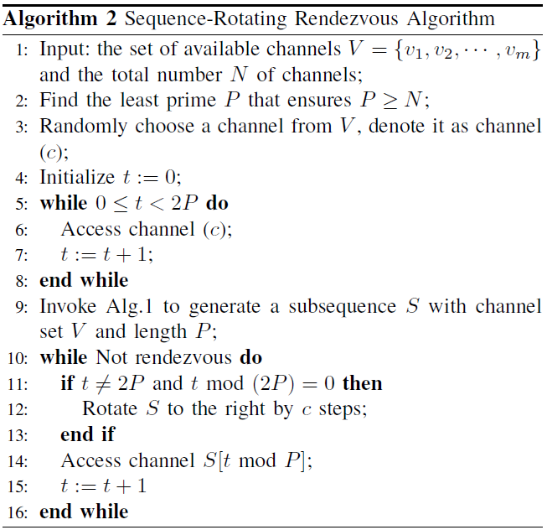
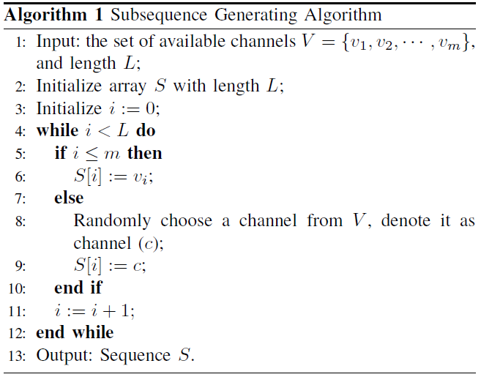
Sequence-Rotating algorithm
An asynchronous anonymous non-oblivious global-sequence-based rendezvous algorithm.
Contains two phases: subsequence generating and subsequence rotating.

Slide 10
Sequence-Rotating algorithm
In subsequence generating phase, for user i, a length P subsequence will be generated, where P is the least prime which is not less that the total channel number N.
In subsequence rotating phase, the subsequence will be rotated to the right according to an already chosen random number c.
The users hop to channels according to the rotated subsequences.
An example when Vi = {1, 3, 5, 6} and N = 6, P = 7, c = 1.

Slide 11
Sequence-Rotating algorithm
SRR algorithm has an MTTR of $2P^{2}+$2P timeslots, which is smaller than existing asynchronous anonymous non-oblivious global-sequence-based rendezvous algorithms when the number G of common available channels between two users is less than $\frac{1}{2}$N.
Regardless of G, SRR has the lowest MTTR among the same type algorithms.

Slide 12
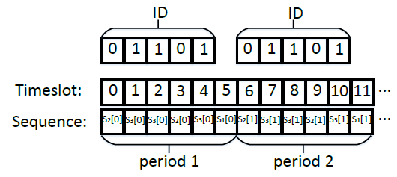
ID-based algorithm
An asynchronous non-anonymous oblivious local-sequence-based rendezvous algorithm.
It creates a channel-hopping sequence
composed of (l +1) subsequences,
where l is the length of user’s ID.
There are there kinds of subsequences:
S1, S2 and S3, whose lengths are
P, P+1, P+2 respectively.
The whole channel-hopping
sequence has a period of (l+1).

Slide 13
ID-based algorithm
IDR algorithm has a lower MTTR than A-HCH-Optimal, A-HCH-η1 and
A-HCH- η2 in general.
IDR algorithm has advantage over CBH in the scenario where the numbers of available channel sets are imbalanced.

Slide 14
Channel-Label-based algorithm
An asynchronous anonymous non-oblivious local-channel-based rendezvous algorithm.
The idea is to randomly choose an available channel and use the binary representation of it as its ID, and utilize the IDR algorithm.
Considering that two users can choose the same channel, let the users to stay on the chosen channel in the first (l+1)PN timeslots, which can enable the two users to rendezvous on that channel.

Slide 15
Channel-Label-based algorithm
CLR algorithm has a smaller MTTR than MTP, though MTP’s MTTR is
O(${\text{max}\text{\{|}\text{Vi}\text{|,|}\text{Vj}\text{|\}}}^{2}$loglog N) order.
Because its constant coefficient is 64, for MTP to gain advantage over CLR, N needs to be larger than $2^{128}, which is impossible.$

Slide 16
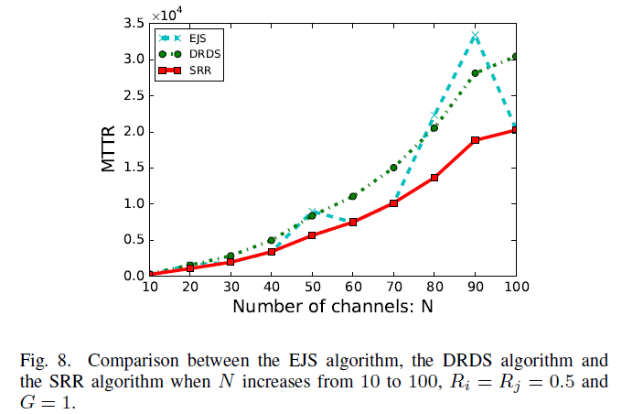
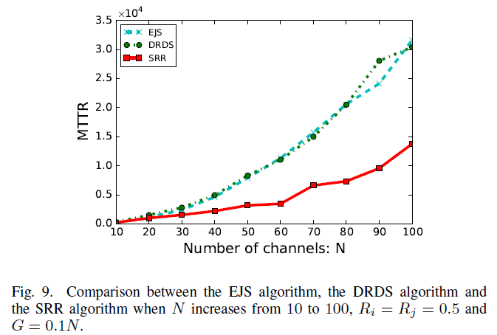
Simulation
Comparing SRR with two representative asynchronous anonymous non-oblivious global-sequence-based rendezvous algorithms-EJS,DRDS.

Slide 17
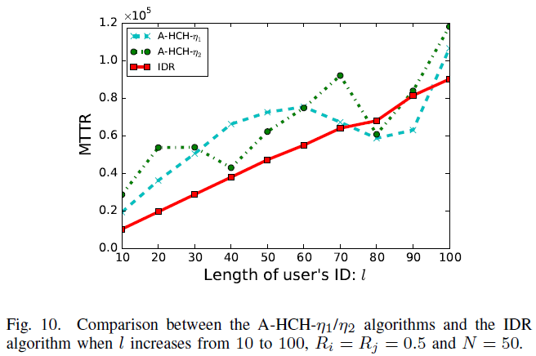
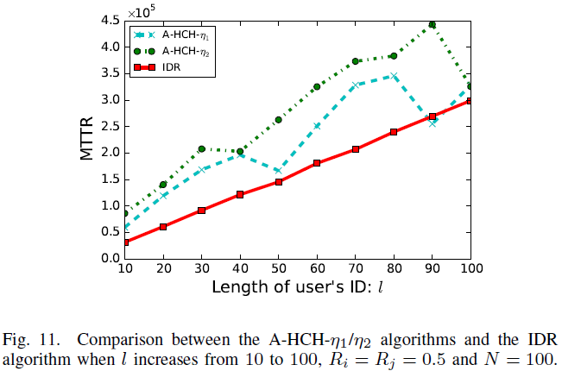
Simulation
Comparing IDR with two representative asynchronous non-anonymous oblivious local-sequence-based rendezvous algorithms – A-HCH-η1 and A-HCH- η2.

Slide 18
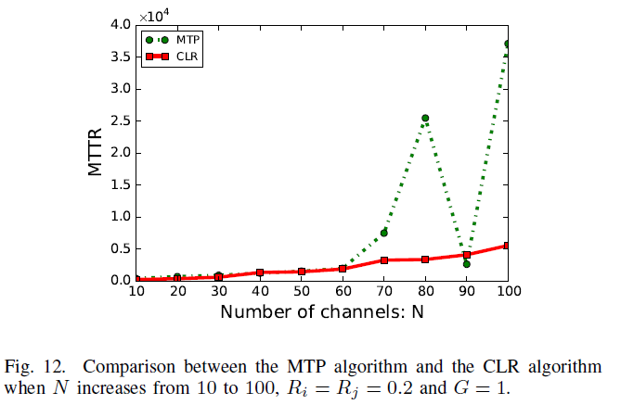
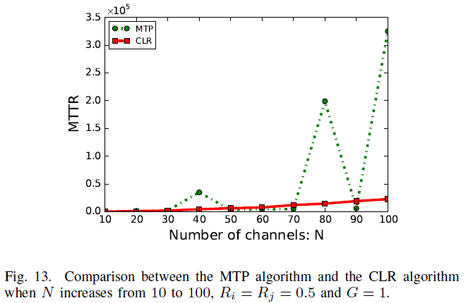
Simulation
Comparing CLR with another asynchronous anonymous non-oblivious local-sequence-based rendezvous algorithm – MTP.

Slide 19
Conclusion
1. This paper propose Sequence-Rotating Rendezvous (SRR) algorithm with an MTTR of ($2P^{2}+2P$) timeslots;
2. This paper propose ID-based Rendezvous (IDR) algorithm with an MTTR of (l + 1)(Pi + 2)(Pj + 2) timeslots;
3. This paper propose Channel-Label-based Rendezvous (CLR) with an MTTR of ((Pi + 2)(Pj + 2) + PN) (⌈log2N⌉ + 1)) timeslots;
4. The theoretical MTTRs of SRR, IDR and CLR are less than those of the state-of-the-art rendezvous algorithms of the corresponding categories respectively in certain scenarios.

Slide 20
Q&A
Thank you!

